Slide 1
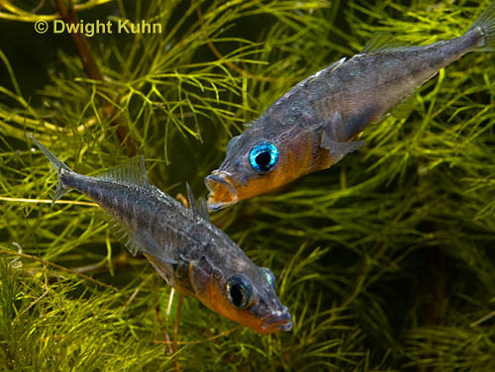
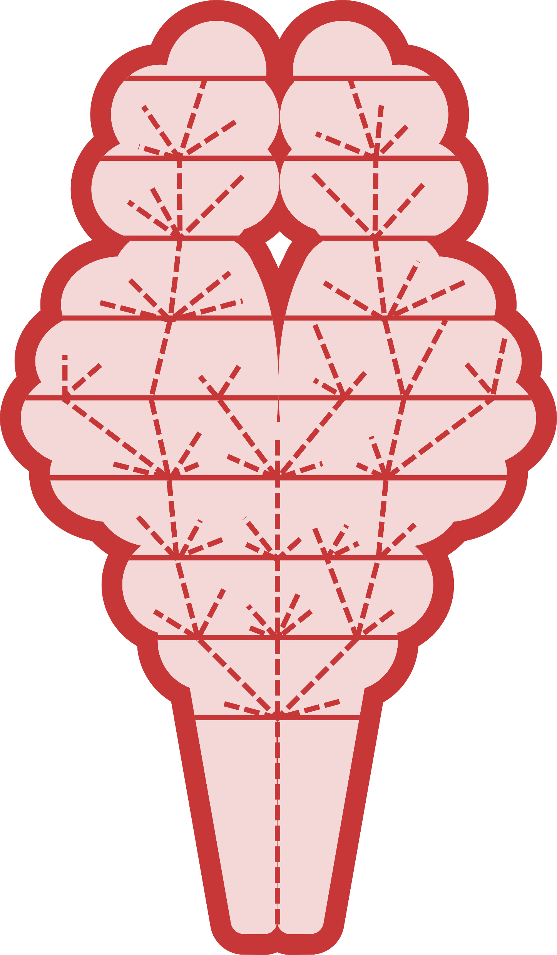
Viral-mediated transgenesis of MAOA and AVP increases territorial aggression in stickleback
Noelle James & Alison Bell
⸺ ♦ ⸺
University of Illinois at Urbana-Champagin
Notes:
Stickleback’s fighting: Dwight Kuhn
Darwin’s Brain Image: Miles Bensky

Slide 2
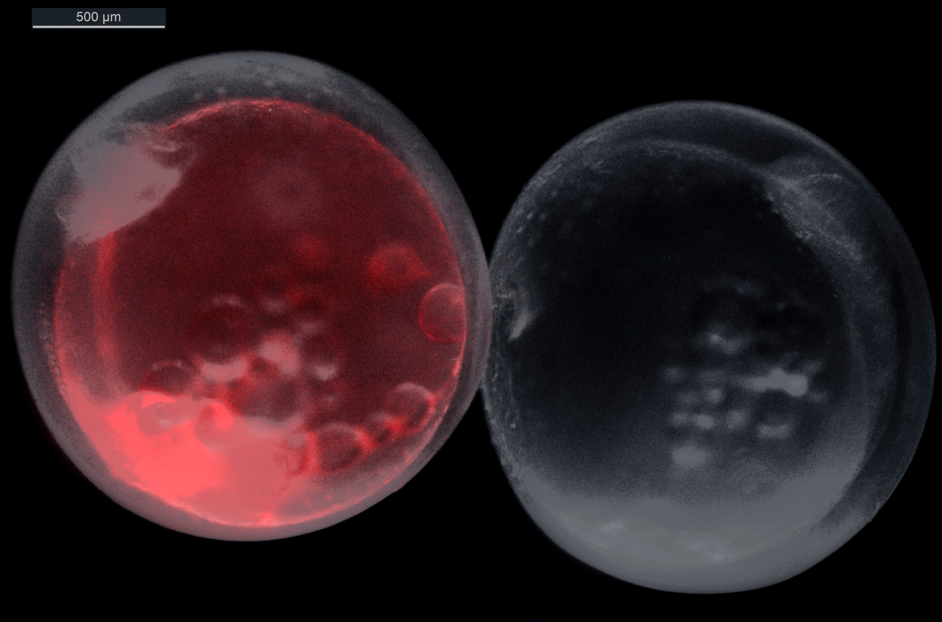
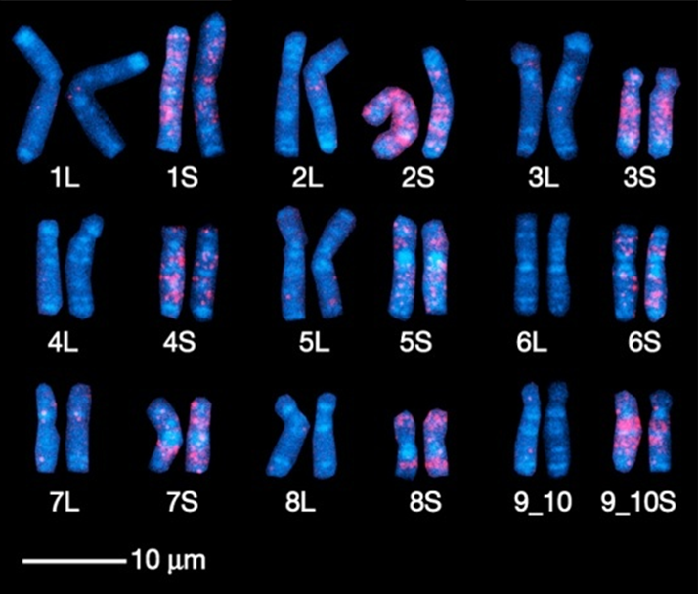
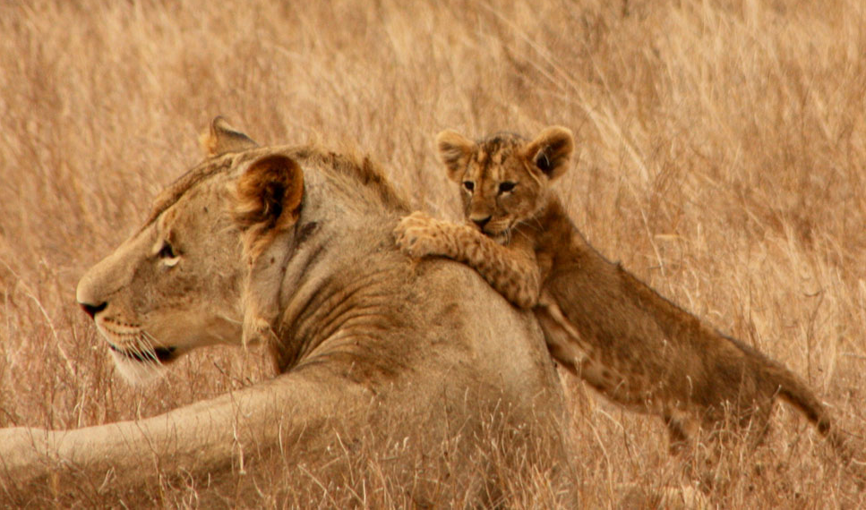
Egg with gene:
How do genes contribute to behavior?
Unchanged
Complex behaviors are heritable
Gene-behavior interplay
Common garden
QTL & GWAS
RNA-seq
Direct manipulation of genes
Knockdown (CRISPR)
Overexpression
now to get at the specific genes
Knockdown
Notes:
How do genes contribute to behavior? We can break this question down into 2 main parts. What behaviors have an underlying genetic component and how do changes in specific genes’ expression alter those behaviors. Thanks to the work of the ecology and animal behavior communities, many complex behaviors have a clearly established genetic component. Using QTL, GWAS, and RNAseq we have identified genes that are associated with behavioral extremes. Now we need to examine the specific causal relationship of how each gene can tune the behavioral output. To do this, we use direct manipulation of the gene, either by decreasing expression such as with CRISPR or by increasing expression, such as viral-mediated transgenesis.
----
Lion image: Anna Langova (publicdomainpictures.net)

Slide 3
Viral-mediated transgenesis
Gene of Interest
Method to locally increase gene expression
Herpes Simplex 1 derived virus
Fast: no stable transgenic lines
Flexible: target different time frames
Directly show a causal relationship between genes and behavior
Allows powerful repeated measures designs
Notes:
Viral-mediated transgenesis is a method to increase a gene expression in a specific location or time. We think about this like a self-driving car, where the destination is the cells we want to influence. Our vehicle is something that can easily get into the cells, like a virus such as herpes. However, we in place of the normal bad Herpes passenger, we put in our gene of interest, which still goes to the programed destination. Thus, we can add an extra gene, like as fluorescence, to our desired cells, like seen here. This method of transgenesis is fast and flexible. We can measure the same animal before and after we alter the genes to allow us to show a causal relationship. Because each animal is its own control the normally problematic noise of natural population variation is cancelled out allowing for the examination of variable behaviors.

Slide 4
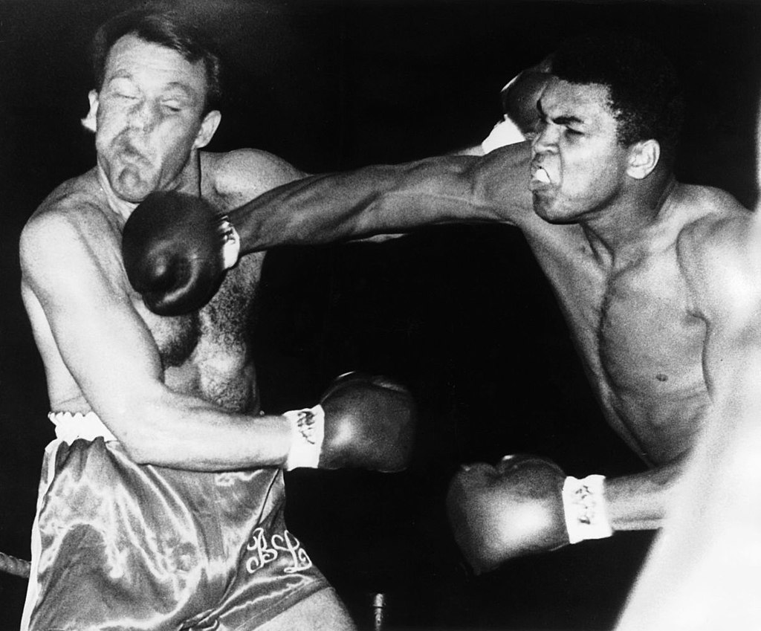
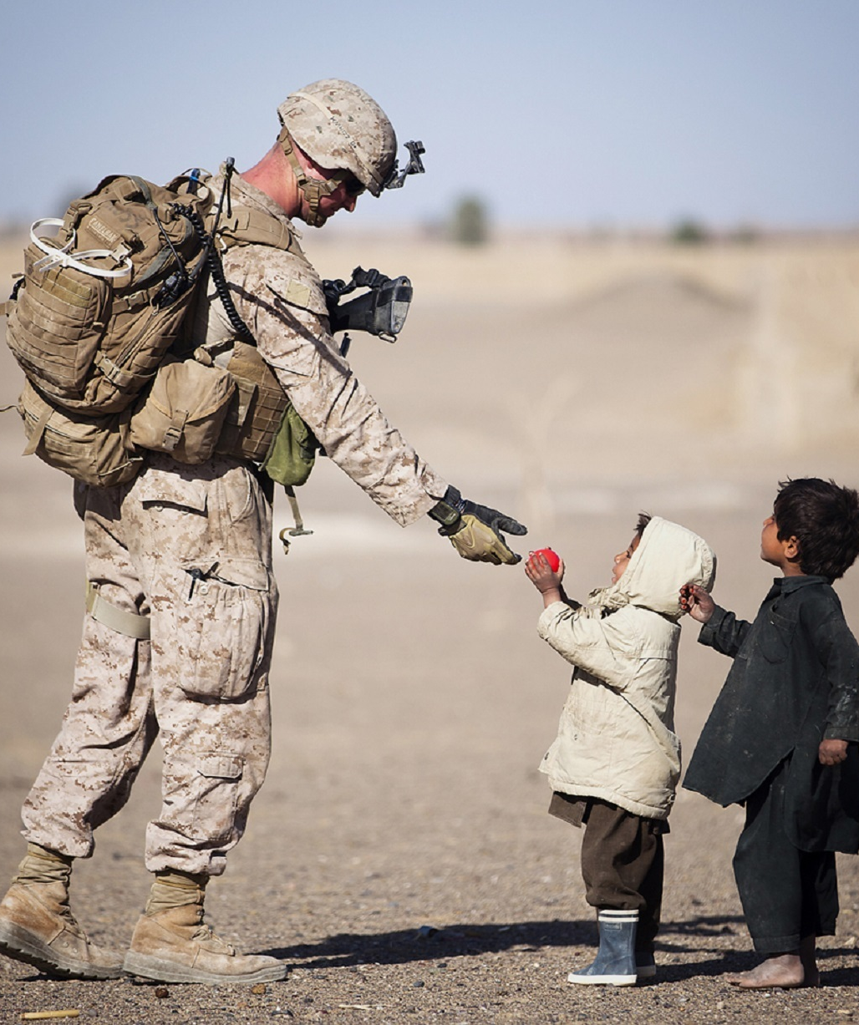
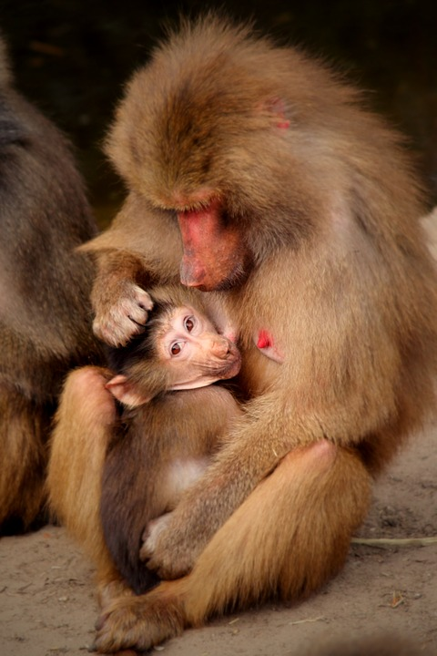
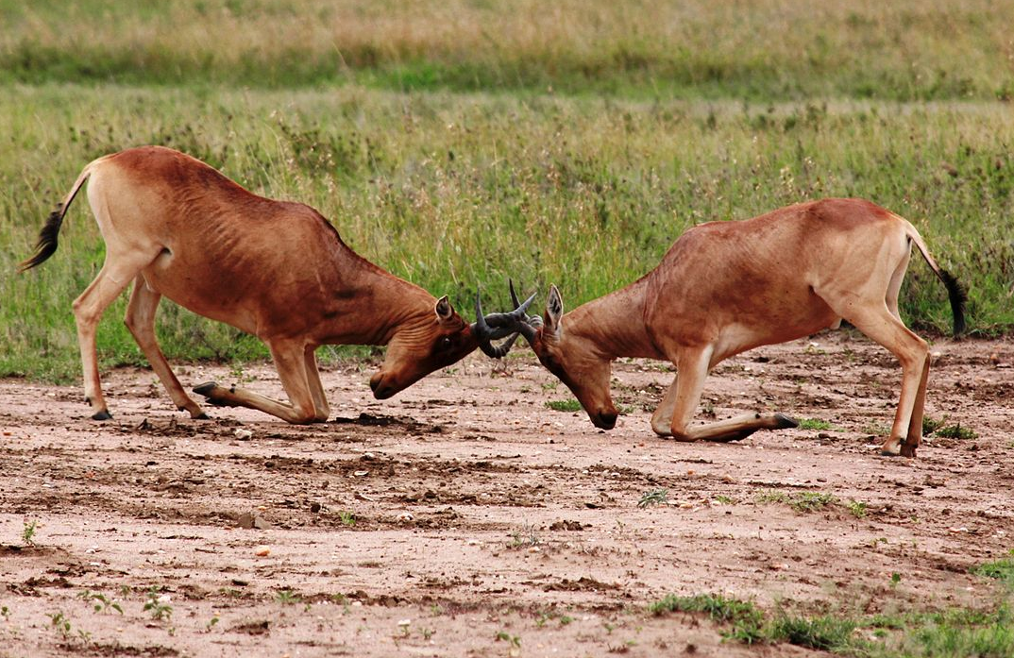
Social behavior
Social behavior is important for:
survival,
chance of reproduction,
offspring survival
Context dependent & complex
with whom?
what is the goal?
Notes:
There are many examples of social behavior including group interactions, territorial & mating competition, and parenting. These interactions are context dependent, depending on the goals of the behavior and with whom the interaction is taking place. For instance, a boxer inside the ring is expected to aggressively fight during a match but stop immediately at the end of a round. Alternatively a soldier should show aggression only to enemy combatants. The time, place and occasion are all factors in determining what behavior is appropriate.
----
Muhammad Ali fights Brian London on August 6, 1966 (Public Domain)
Soldier Giving Red Fruit on 2 Children during Daytime by pixabay.com (Free to use)
Male hartebeest locking horns and fiercely defending their territories. An example of direct competition. By Filip Lachowski (CC-BY-SA)
Mother monkey by Moonpieandsometea on pixabay.com (Free to use)

Slide 5
Stickleback fish
Dad
Classic system for behavior, ecology & evolution
Nest
Males nest & parent
Fully sequenced genome
Established behavioral assays
Many candidate genes for behavior
Seasonal territorial aggression
Intruder
Resident
Notes:
Stickleback fish are interesting because they have a variety of complex social behaviors as well as a growing number of genetic methods. DADs provide both care for the young and protect their nesting territory in the breeding season. Here you can see a dad working on his nest. Threespine sticklebacks have a fully sequenced genome, established behavioral assays and numerous candidate genes for both parenting and aggression. They have seasonal territorial aggression such as seen in this ‘flask assay’.

Slide 6
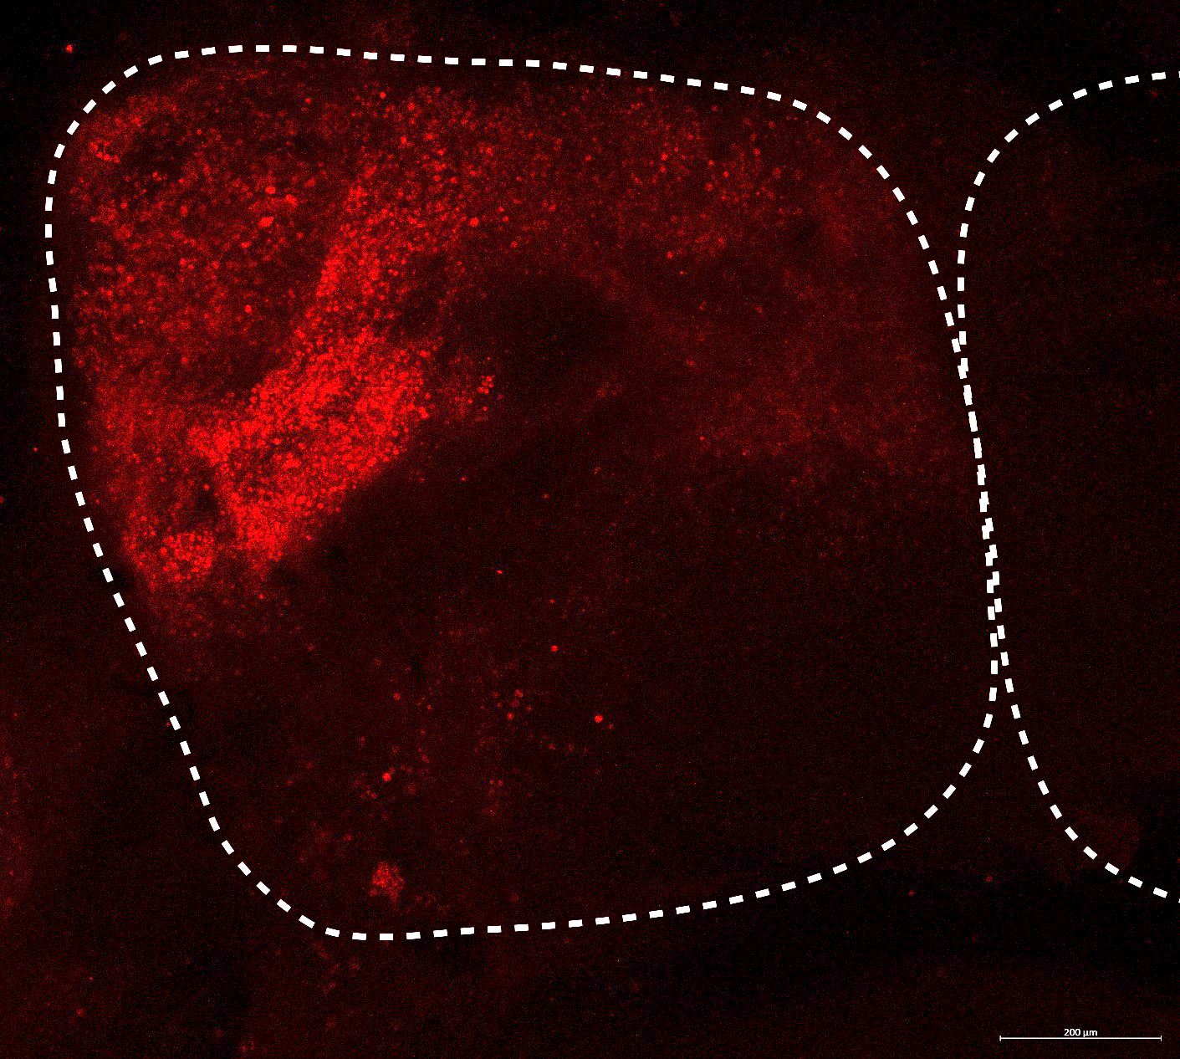
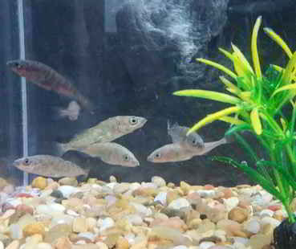
Goal
Candidate
Genes
Demonstrate changes in behavior caused by increased expression of candidate genes
Surgical
Rig
Transfected cells (hCMV-mCherry)
Experimental
Design
Aggression
Arginine vasopressin (AVP)
Monoamine oxidase (MAOA)
Results
Notes:
My goal was to show changes in behavior cause by increased expression of select candidate genes. Specifically, I choose to work with aggression because there are several well studied candidate genes, like AVP and MAOA. For this study, I will go over the genes, surgical rig, experimental design and then my results. First off..

Slide 7
Arginine vasopressin
Phe
Gln
Prediction
↑ AVP = ↑ aggression
Try
Asn
Cys
Cys
pituitary hormone
highly conserved
important for social behavior, learning, and memory
Known to increase aggression
Proof-of-concept
Pro
Arg
Gly
Fishes | Vasotocin | C | Y | I | Q | N | C | P | R | G
Amphibians, Reptiles & Birds | Vasotocin | C | Y | I | Q | N | C | P | R | G
Mammals | Vasopressin | C | Y | F | Q | N | C | P | R | G
C | Y | I | Q | N | C | P | R | G
C | Y | I | Q | N | C | P | R | G
C | Y | F | Q | N | C | P | R | G
Notes:
AVP is pituitary hormone that is highly conserved with only a single amino acid change between fish and mammals. It is important for social behavior, learning, and memory. Further, its role in aggression is firmly established and so we expect that overexpressing AVP will lead to increased aggression.

Slide 8
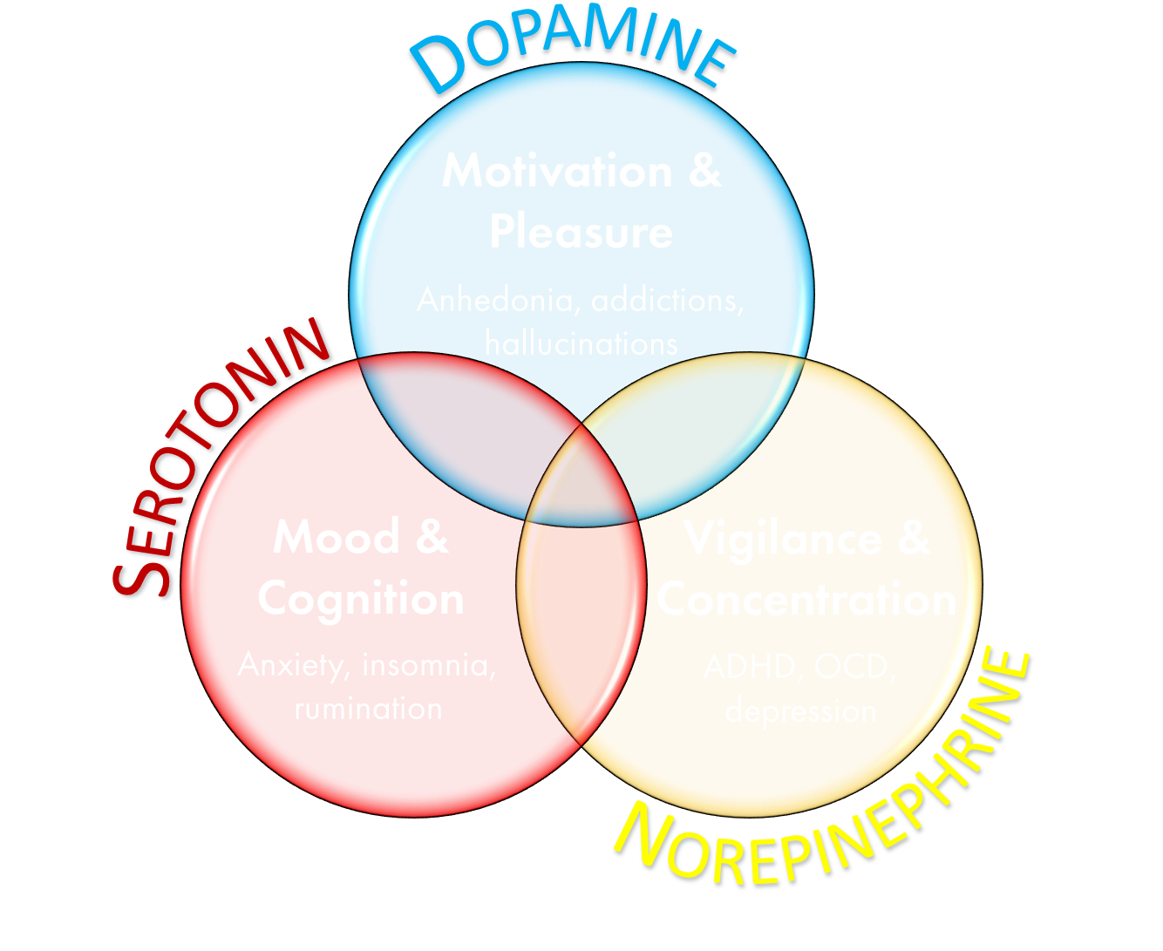
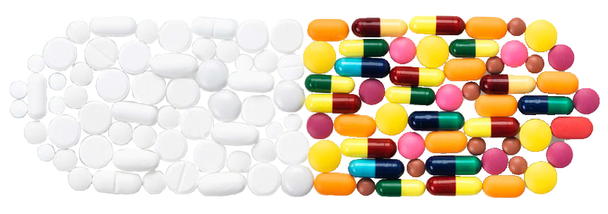
Monoamine oxidase
Prediction
↑ MAOA = ↓ 5-HT = ↓ aggression
enzyme that processes dopamine, serotonin, and norepinephrine
associated with depression, antisocial disorders, and Brunner syndrome
Notes:
Monoamine oxidase is an enzyme responsible for processing dopamine, norepinephrine & serotonin. It has long been tied to depression with the 1st generation of antidepressants being MAO inhibitors. As such it has been heavily studied in the context of depletion, which leads to increased aggression. Recent work in mice has shown that overexpression increased anxiety leading to affiliative behavior. Thus, we expected that that overexpression will decrease dopamine, norepinephrine & serotonin resulting in decreased aggression.
-----
Pill of Pills modified from Consumer reports, Shutterstock

Slide 9
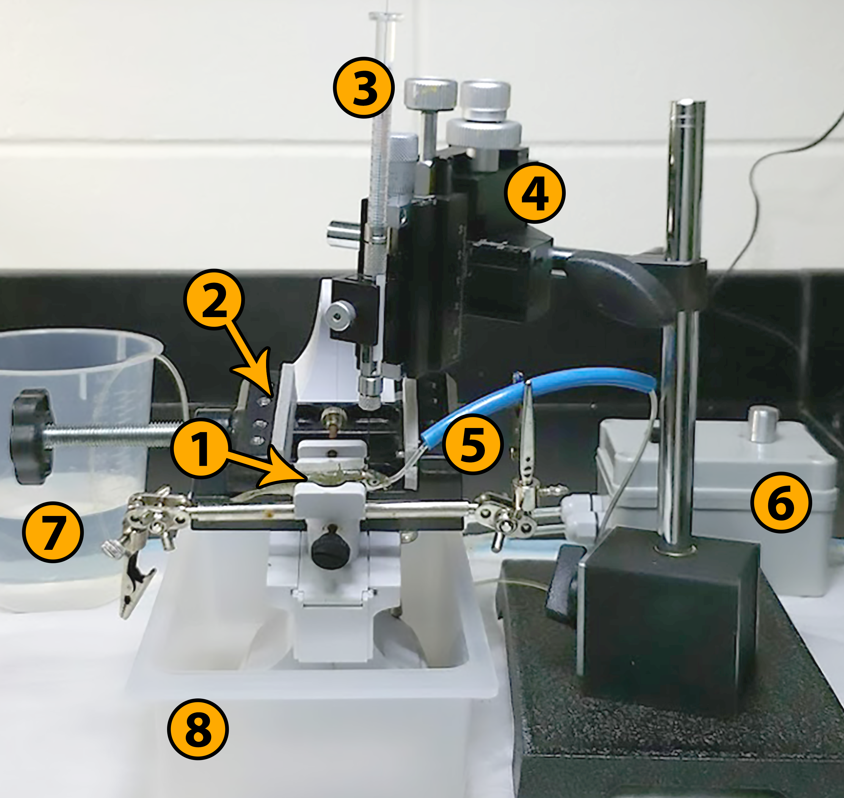
Custom-built surgical apparatus
1
Padded clamp with stickleback
2
Alternative clamp for larger fish
3
Neuros syringe, 5 μL
4
Three-axis manipulator
5
Oral cannula and guide tube
6
Peristaltic cannula pump, 100 ^{mL}/_{min}
7
Pump source reservoir
8
Drip tray
Notes:
To allow us to do controlled brain injections delivering the viral construct we built a custom surgical rig. This allows for ~10 minute out-of-water procedure with continuous anesthesia. We had good survival rates and success with initial fluorescent protein testing as you saw in the cells earlier. Therefore, I moved on to verify that viral-mediated transgenesis is capable of resulting in detectable behavioral level changes.

Slide 10
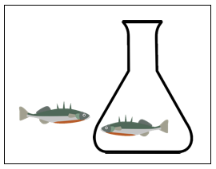
Methods
Measures
Recovery/stress
Breathing Rate
Territorial aggression
Charges
Constructs
Control (EYFP), n=16
AVP (human), n=18
MAOA (mouse), n=20
Off-the-shelf
Focal ♂
Notes:
Each fish was subjected to 2 behavioral trials before injection and after the construct reached peak expression. Breathing rate was taken prior to each behavioral trial. Each trial consisted of exposing a resident male to the same* intruder and recording the resulting 5 minutes of behavior. I will focus on charges, which has traditionally been considered voluntary initiation of aggression.
We tested our two candidate genes and a control group with ordered ready-to-use constructs, because I wanted this technique to be easily accessible to those less comfortable in the lab.

Slide 11
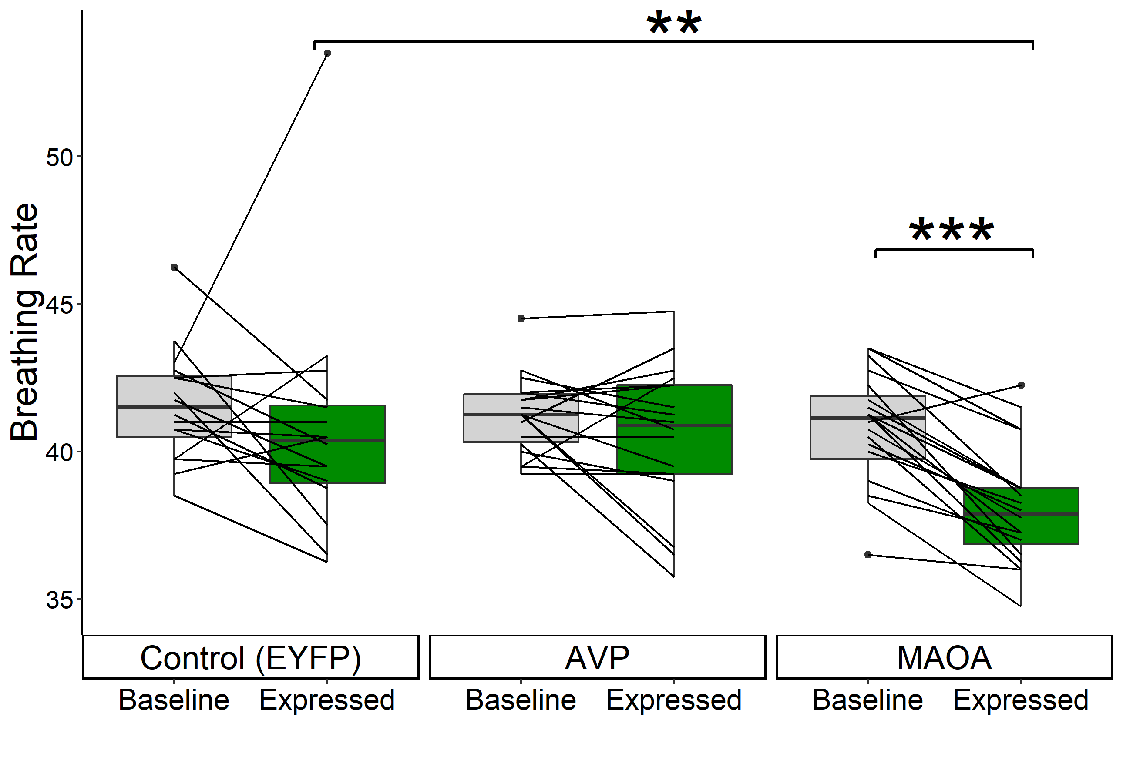
Decreased breathing rate by only MAOA
Expected Mechanism
MAOA processes 5-HT & NE both of which increase respiration.
↑ MAOA leads to ↓ 5-HT/NE resulting in ↓ breathing
No change in control or AVP expressing fish
Notes:
Breathing rate was decreased in only fish who were overexpressing MAOA. Here we have a standard boxplot with lines for each individual overlaid on top. You can see that all groups were similar at baseline and no significant change was see with control or AVP expressing fish. However, 19 of the 20 fish with extra MAOA had decreased breathing rate following expression. This effect is strong enough to also be detected directly between treatments.

Slide 12
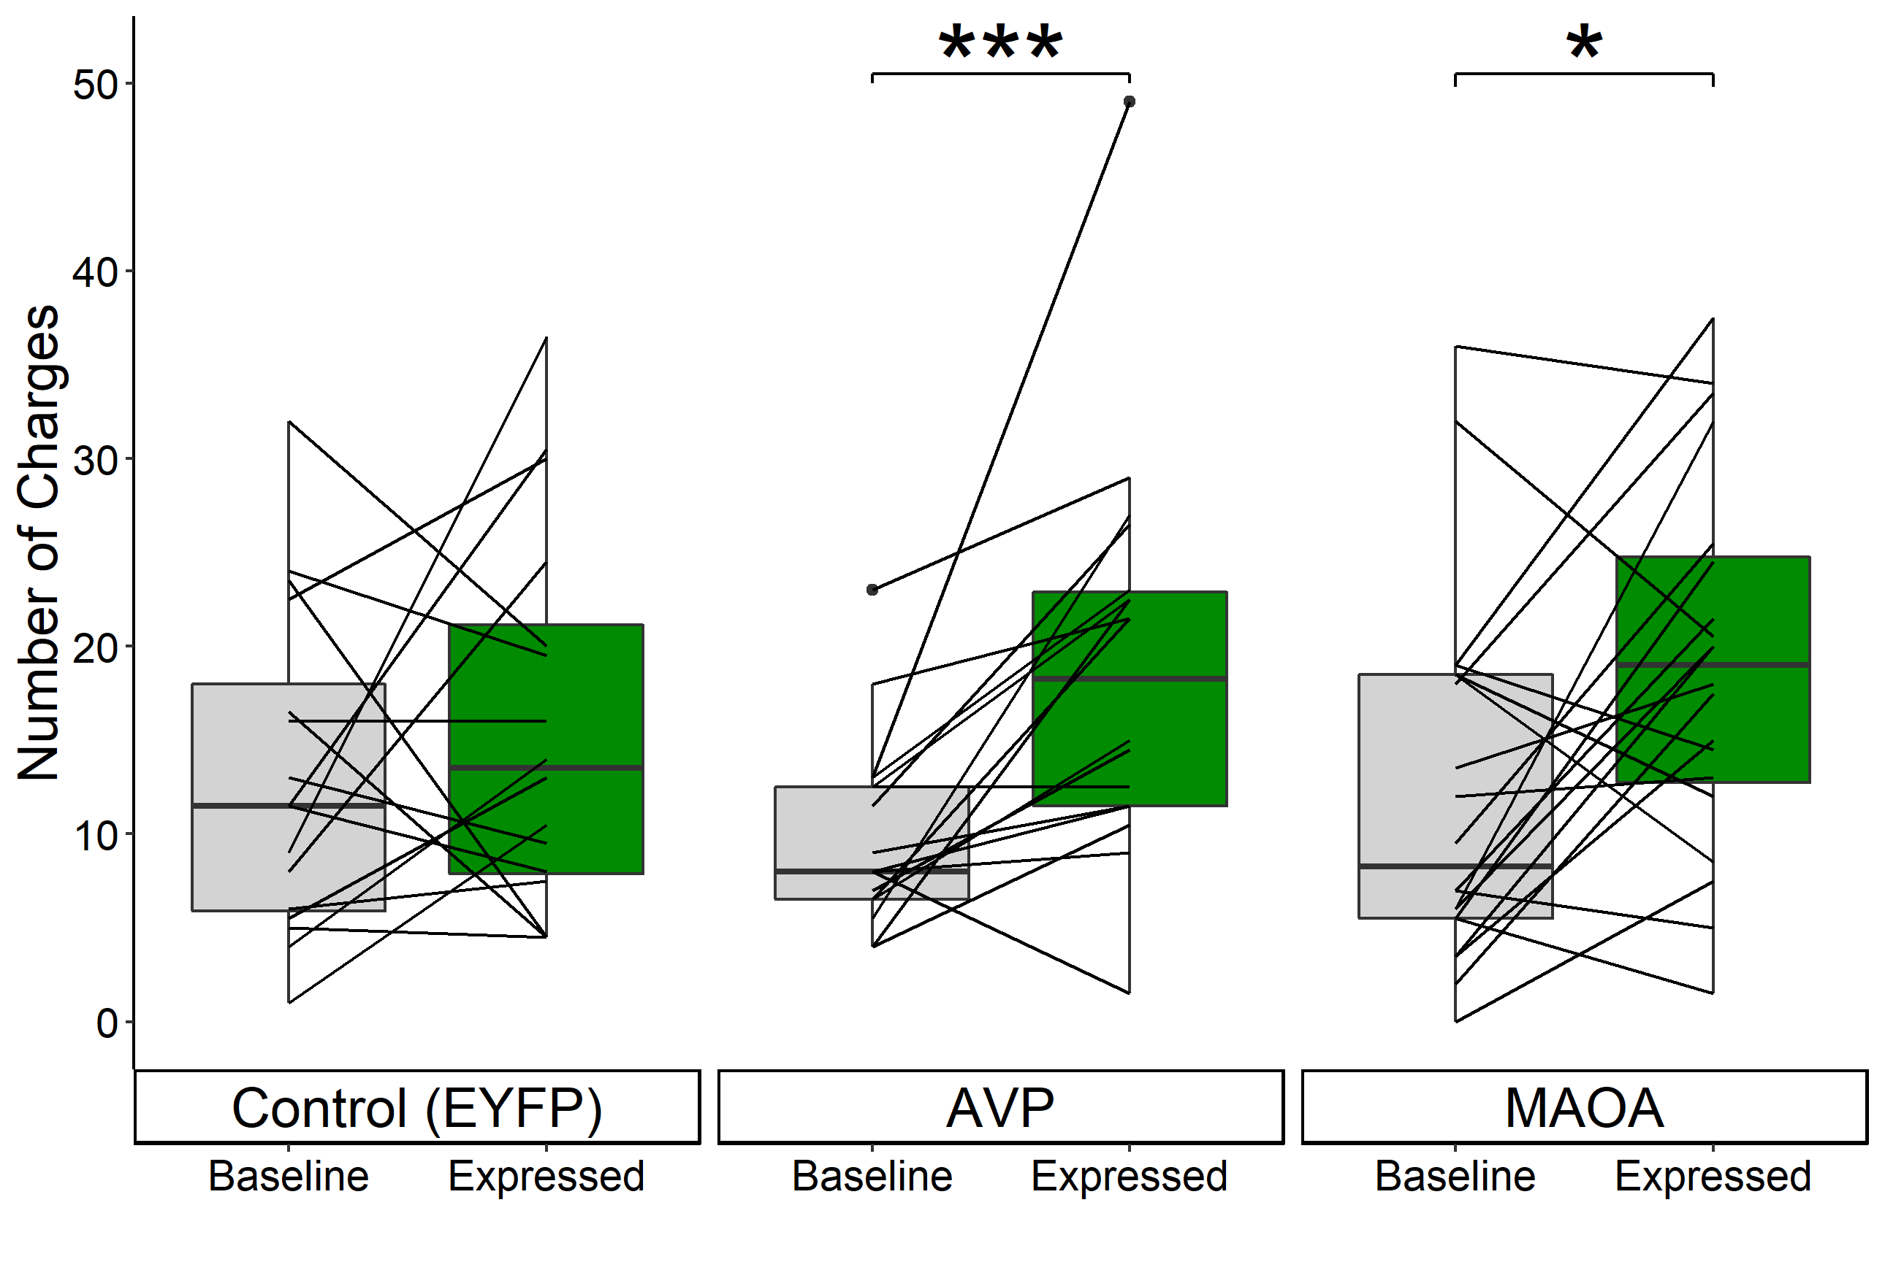
Increased aggression for AVP and MAOA
Territorial aggression increased in expressing both candidate genes
Wilcoxon signed rank, paired
No change in any behavior in control fish
AVP | Z = -3.1 | p = 0.001
MAOA | Z = -2.1 | p = 0.02
Notes:
Behaviorally, we did see a change following the overexpression of either AVP or MAOA. Again we have a standard boxplot with lines for each individual overlaid on top. All groups had similar numbers of charges at baseline. As expected, AVP expression caused a strong increase in aggression. Interestingly through, MAOA overexpression also increased aggression, although the effect was not as strong as the one seen in AVP. This increase in still likely the result of anxiety.

Slide 13
Conclusions
AVP confirms viral-mediated transgenesis can demonstrate causal links between genes and behavior.
Repeated measures drastically reduces required sample size
Comparison | Behavior |  | Physiology
 | AVP | MAOA | MAOA
Effect size (r) | 0.79 | 0.53 | 0.85
Variation (σ²) | 113 | 99.9 | 3.9
Non-repeated measures Sample size (n) | 277 | 187 | 35
Actual sample size (n) | 18 | 20 | 20
Full data set
Notes:
For those interested the full data set is available on the open science framework. Increased aggression following overexpression of vasopressin confirms viral-mediated transgenesis can be used to demonstrate changes in behavior caused by specific genes. By using repeated measures on the same fish before and after treatment we were able to drastically reduce the necessary sample size. For instance in this study we found an effect size of between .5 and .8 for behavior and .85 for breathing rate.

Slide 14
Conclusions
AVP confirms viral-mediated transgenesis can demonstrate causal links between genes and behavior.
Repeated measures drastically reduces required sample size
Comparison | Behavior |  | Physiology
 | AVP | MAOA | MAOA
Effect size (r) | 0.79 | 0.53 | 0.85
Variation (σ²) | 113 | 99.9 | 3.9
Non-repeated measures Sample size (n) | 277 | 187 | 35
Actual sample size (n) | 18 | 20 | 20
Full data set
Notes:
For those interested the full data set is available on the open science framework. Increased aggression following overexpression of vasopressin confirms viral-mediated transgenesis can be used to demonstrate changes in behavior caused by specific genes. By using repeated measures on the same fish before and after treatment we were able to drastically reduce the necessary sample size. For instance in this study we found large effect sizes for behavior and breathing rate – a typically physiological measure. However, variation within the population was about 27x larger for behavior compared to breathing rate. Thus, if we wanted to compare between groups we would need the entirely impractical sample size of 200-300. However, by using these methods we were able to reduce the sample size down to the manageable size of ~20.

Slide 15
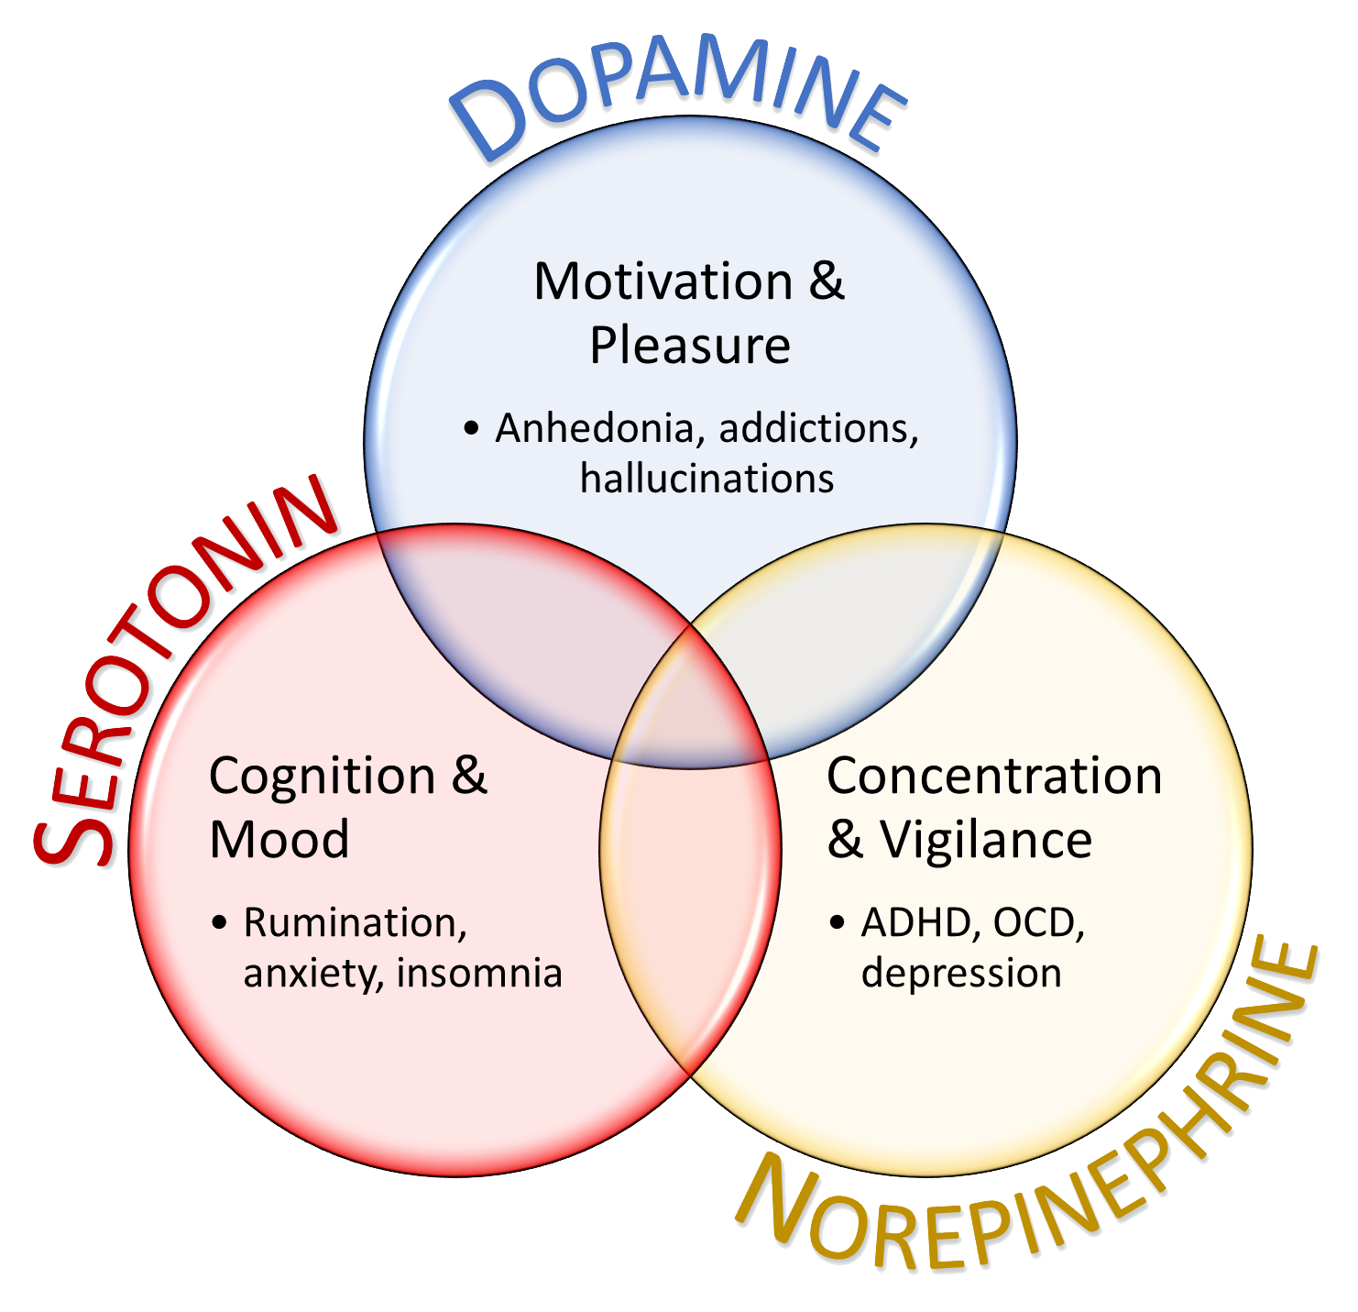
Conclusions
AVP confirms viral-mediated transgenesis can demonstrate causal links between genes and behavior.
Repeated measures drastically reduces required sample size
Overexpression of MAOA increased territorial aggression in sticklebacks.
Decreased breathing rate shows that MAOA is functioning as expected
Comparison | Behavior |  | Physiology
 | AVP | MAOA | MAOA
Effect size (r) | 0.79 | 0.53 | 0.85
Variation (σ²) | 113 | 99.9 | 3.9
Non-repeated measures Sample size (n) | 277 | 187 | 35
Actual sample size (n) | 18 | 20 | 20
Full data set
Notes:
In addition to validating this method, we found the unexpected result that increasing MAOA expression resulted in increased aggression. The decrease in breathing rate shows that MAOA is functioning as expected – enzymatically lowering levels of dopamine and norepinephrine. Thank you for your time. Before I take questions I would like to thank…

Slide 16
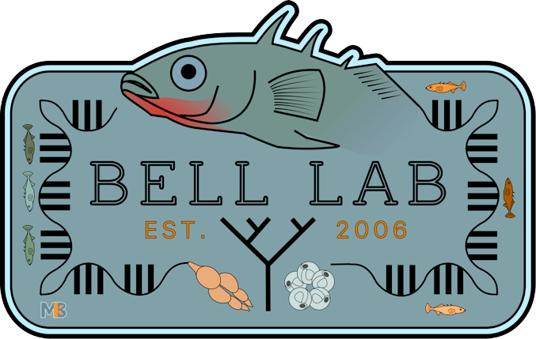
Acknowledgments
Construct Source Rachael Neve, Massachusetts General Hospital
Technical Advice & Equipment Roberto Galvez Rhanor Gillette Gene Robinson’s Lab
Graduate Committee Alison Bell Lisa Stubbs Lori Raetzman Justin Rhodes
Colby Behrens Severin Odland Jennifer Hellmann Jason Keagy Abbas Bukhari Miles Bensky Erika Carlson Katie Julkowski
Previous Members Rebecca Trapp Molly Kent Laura Stein Emma Murdoch Rosie Zhang Undergraduates Joe Dobbins Megan Furukawa Kelly Hynes Sigrid Jin Brianna Bowman Jennifer Weiss Leslie Pardo Andrew Gensburg Jonathan Sanders Ali Norwood
This work was supported by the National Science Foundation under EDGE Grant 1645170
Contact Me
Notes:
Rachael Neve who supplied to ready-to-use constructs. Finally, the NSF who generously funded this method development work with an EDGE grant.
With that, I would like to thank you for your attention and am happy to take any questions you might have.

