Slide 1
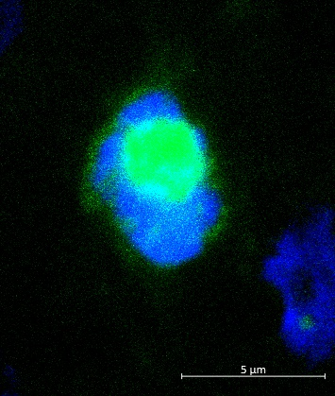
Fishing for genetic effects on social behavior: Viral-mediated transgenesis in stickleback fish
Noelle James and Alison Bell
University of Illinois at Urbana-Champaign
Nuclei (DAPI)
Transfected cell (hCMV-EYFP)
Notes:
Hello. My name is Noelle James and I am a Neuroscience graduate student in Dr. Alison Bell’s lab at the University of Illinois. Today I am going to tell you about our work on determining how genes can contribute to social behavior and the method I have developed to help us address this question in our research organism, the stickleback fish.

Slide 2
Talk Outline: How do genes contribute to social behavior?
Social Behavior
Stickleback Fish
Results & Future Work
Goal & Methods
Notes:
First I will give a quick introduction into social behavior and why its important. Then I will introduce you to stickleback fish, the interesting system we use in the lab. I will give you a brief overview of the experimental setup and my results. Finally, I will wrap up with our plan to use this method to determine how candidate genes are contributing to social behavior.

Slide 3
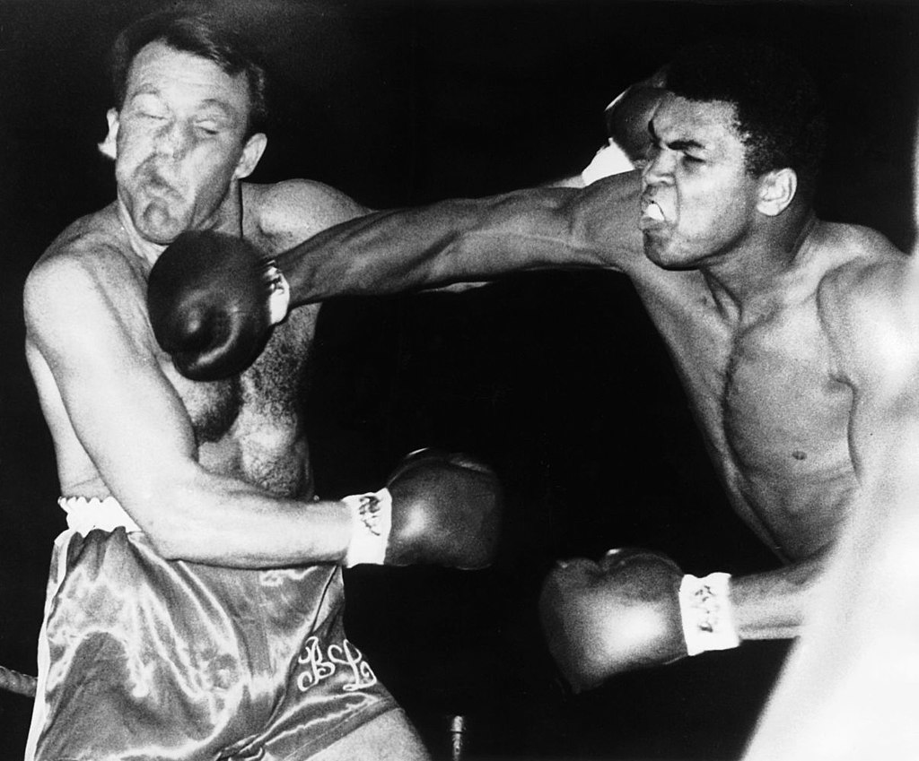
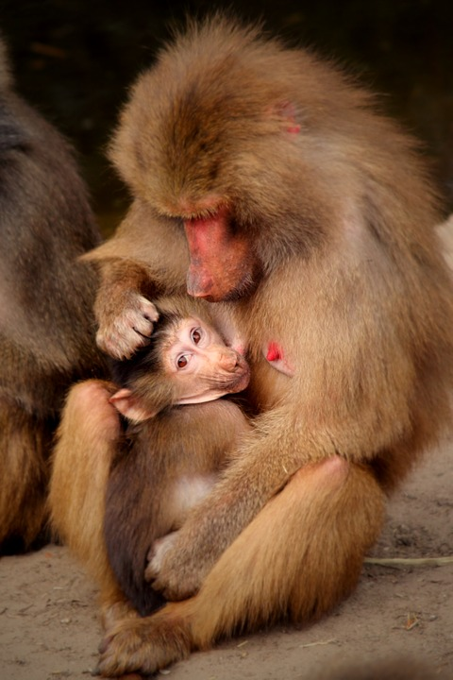
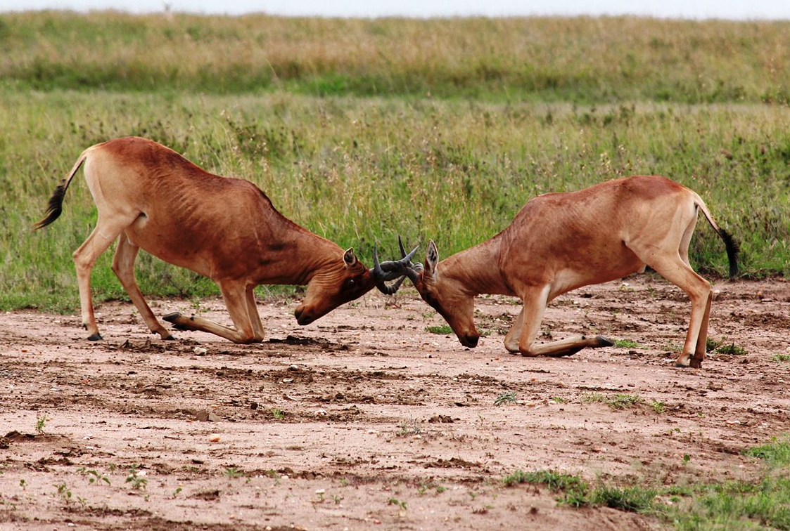
Social Behavior
Influences survival, chance of reproduction and offspring survival
Context Dependent & Complex
With whom?
What is the goal?
Notes:
There are many examples of social behavior including group interactions, territorial & mating competition, and parenting. These interactions are context dependent, depending on the goals of the behavior and with whom the interaction is taking place. For instance, a boxer inside the ring is expected to aggressively fight during a match but stop immediately at the end of a round. Alternatively a soldier show only show aggression to enemy combatants. The time, place and occasion are all factors in determining what behavior is appropriate.
--------
Context dependent
Seasonality
Caution (responsive) verses action (preemptive)
Influenced by life history (predation rate, breeding frequency)
Non-responsive aggression is a defining feature of defining feature of pathological/maladative aggression
Complexities:
With whom?
Within and between species competitions
What is the goal?
Aggression: Personal survival, defense of resources, threat/minor harm, kill (eat)
Care: Parental, mating or group member

Slide 4
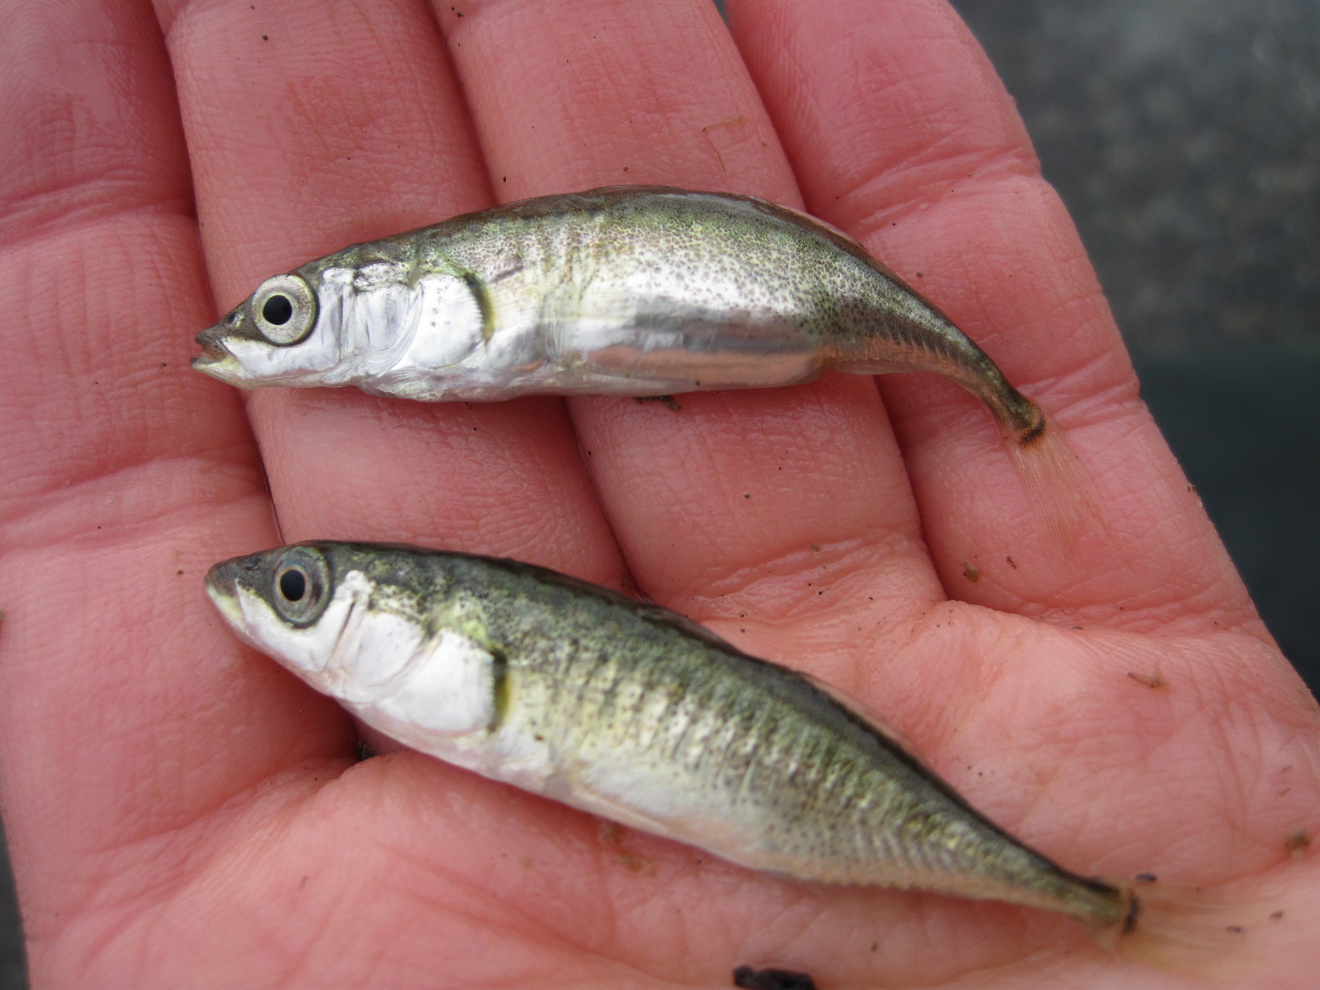
Stickleback Fish
Classic system for behavior, ecology & evolution
Male parental care
Aggressive defense of nesting territory
Notes:
Stickleback fish are interesting for studying social behavior because DADs provide both care for the young and protect their nesting territory in the breeding season. They need to vigorously defend their territory not only from other stickleback fish but also from predators who might eat their young. They need to rapidly switch between aggression and parental care. In this video, we will see the dad (POINT) first provide care to his nest by fanning it to provide extra oxygen and then drive off other stickleback fish. PLAY This social behavior requires precise context switching, which brings us back to the big question of …

Slide 5
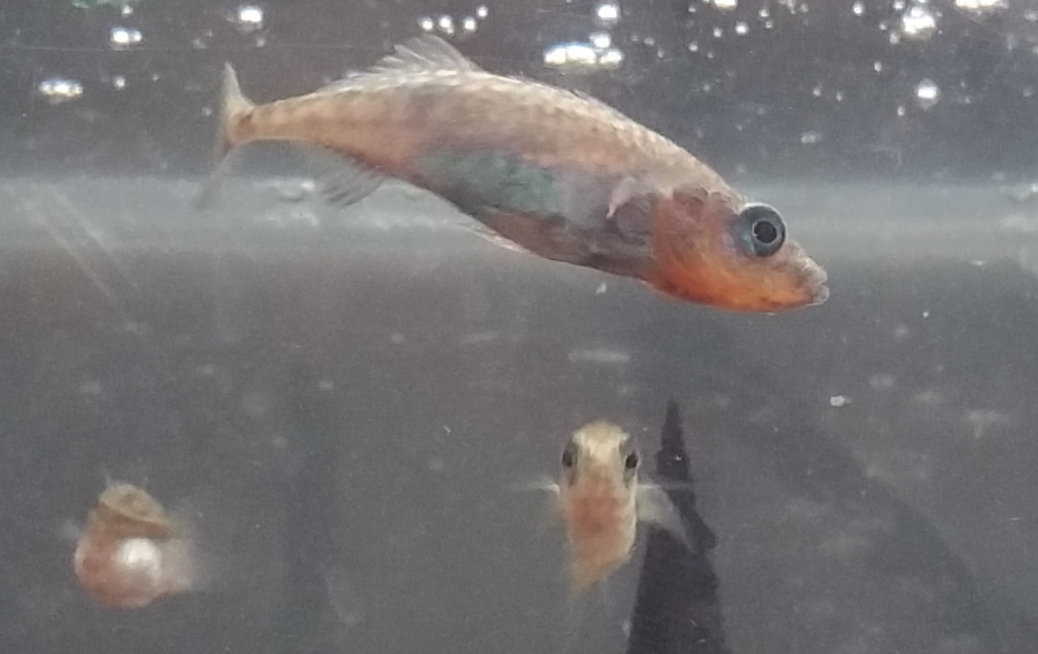
Big Question
How do genes contribute social behavior?
Which genes?
Where?
When?
Aggression
Parenting
Context switching
Select genes to study
Manipulate gene expression
Look for effects on behavior
Notes:
How do genes contribute to social behavior? We can break this question down into 2 main parts. The genes - for which we need to know which genes, as well as where and when they are expressed. Then we need to answer these questions for various social behaviors before we can address how a decision is made between behaviors. To address these questions, we needed a method to influence a gene expression in a specific location and at a specific time in the brain.

Slide 6
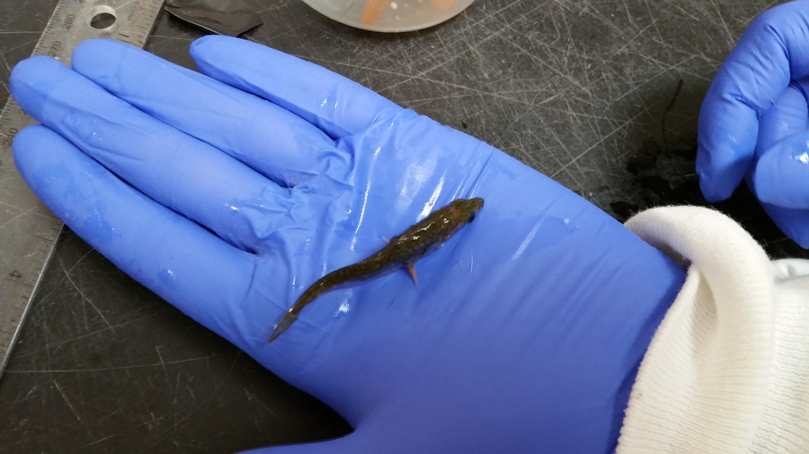
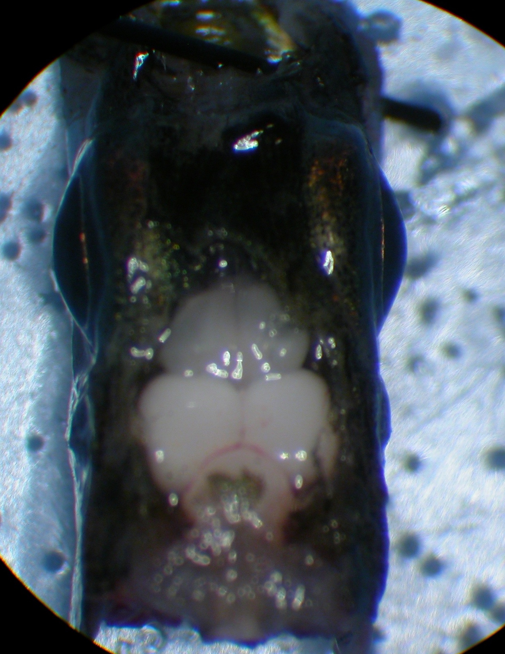
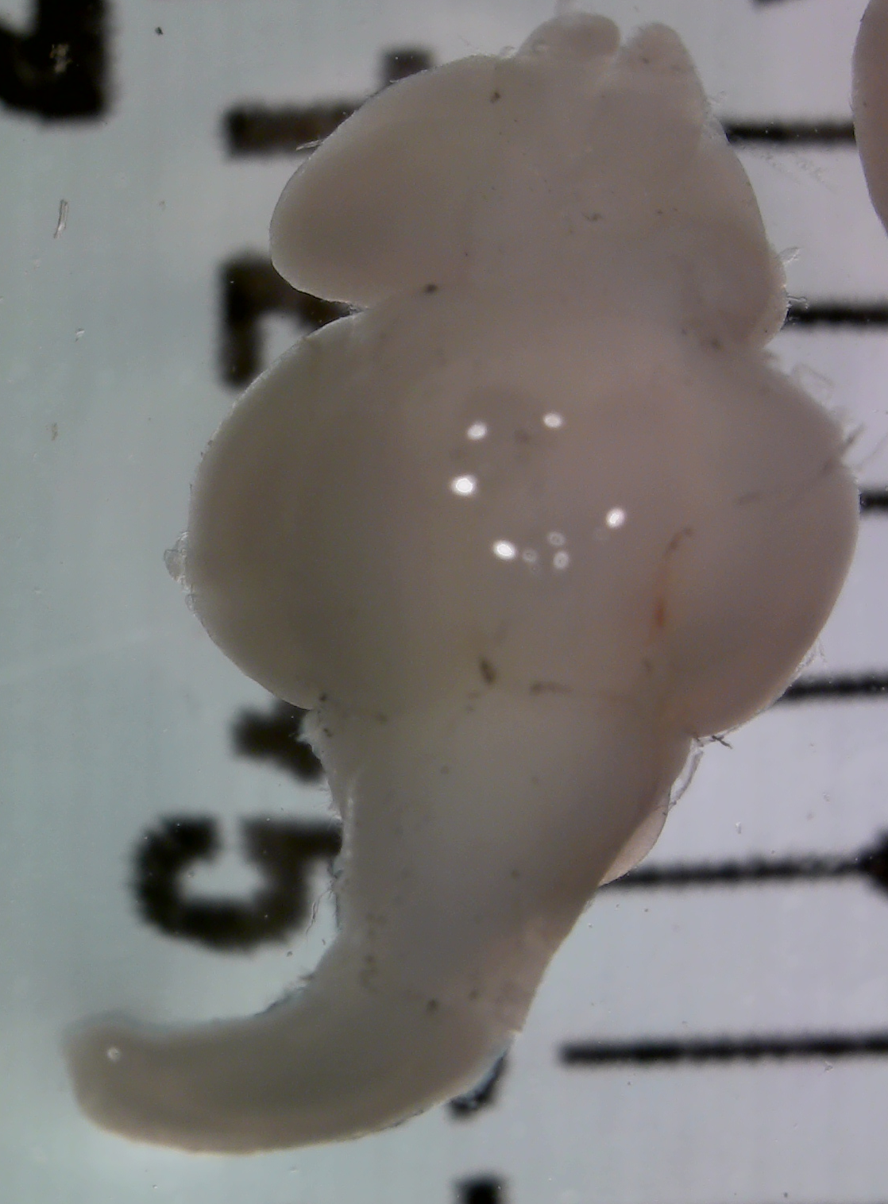
Goal: Method to locally change gene expression
Influence a limited set of cells at a specific time
Continuous expression of a target gene in the brain can be driven by Herpes Smplex 1 (HSV1) derived virus with mCMV, hCMV or hEF1a promoters
Notes:
Therefore, I have been working to develop a method to allow us to inject a virus containing a promotor to drive expression of a desired gene. To give you a feel for what I am working with, here is a full grown stickleback fish on the palm of my hand. These fish are approximately 4 cm long and this white dot is its brain, which is magnified here. To develop this method, we need to hit a region that is only millimeters in size, through the skull. However, doing so would allow us to …

Slide 7
Goal: Method to locally change gene expression
Influence a limited set of cells at a specific time
Promotor
Cell
Herpes Simplex 1 (HSV1) derived virus
Notes:
…influence a gene’s expression in the specific location of the injection and at a specific time. We think about this like parking in a garage. The garage is the cells we want to influence. Our vehicle is something that can easily get into the cells, like a virus such as herpes. Finally, we have a driver or gene promotor, who controls when and where the car goes. In my experiment, we tried 3 different promotors or drivers to determine which would be most useful for specifically controlling where and when we could manipulate gene expression.

Slide 8
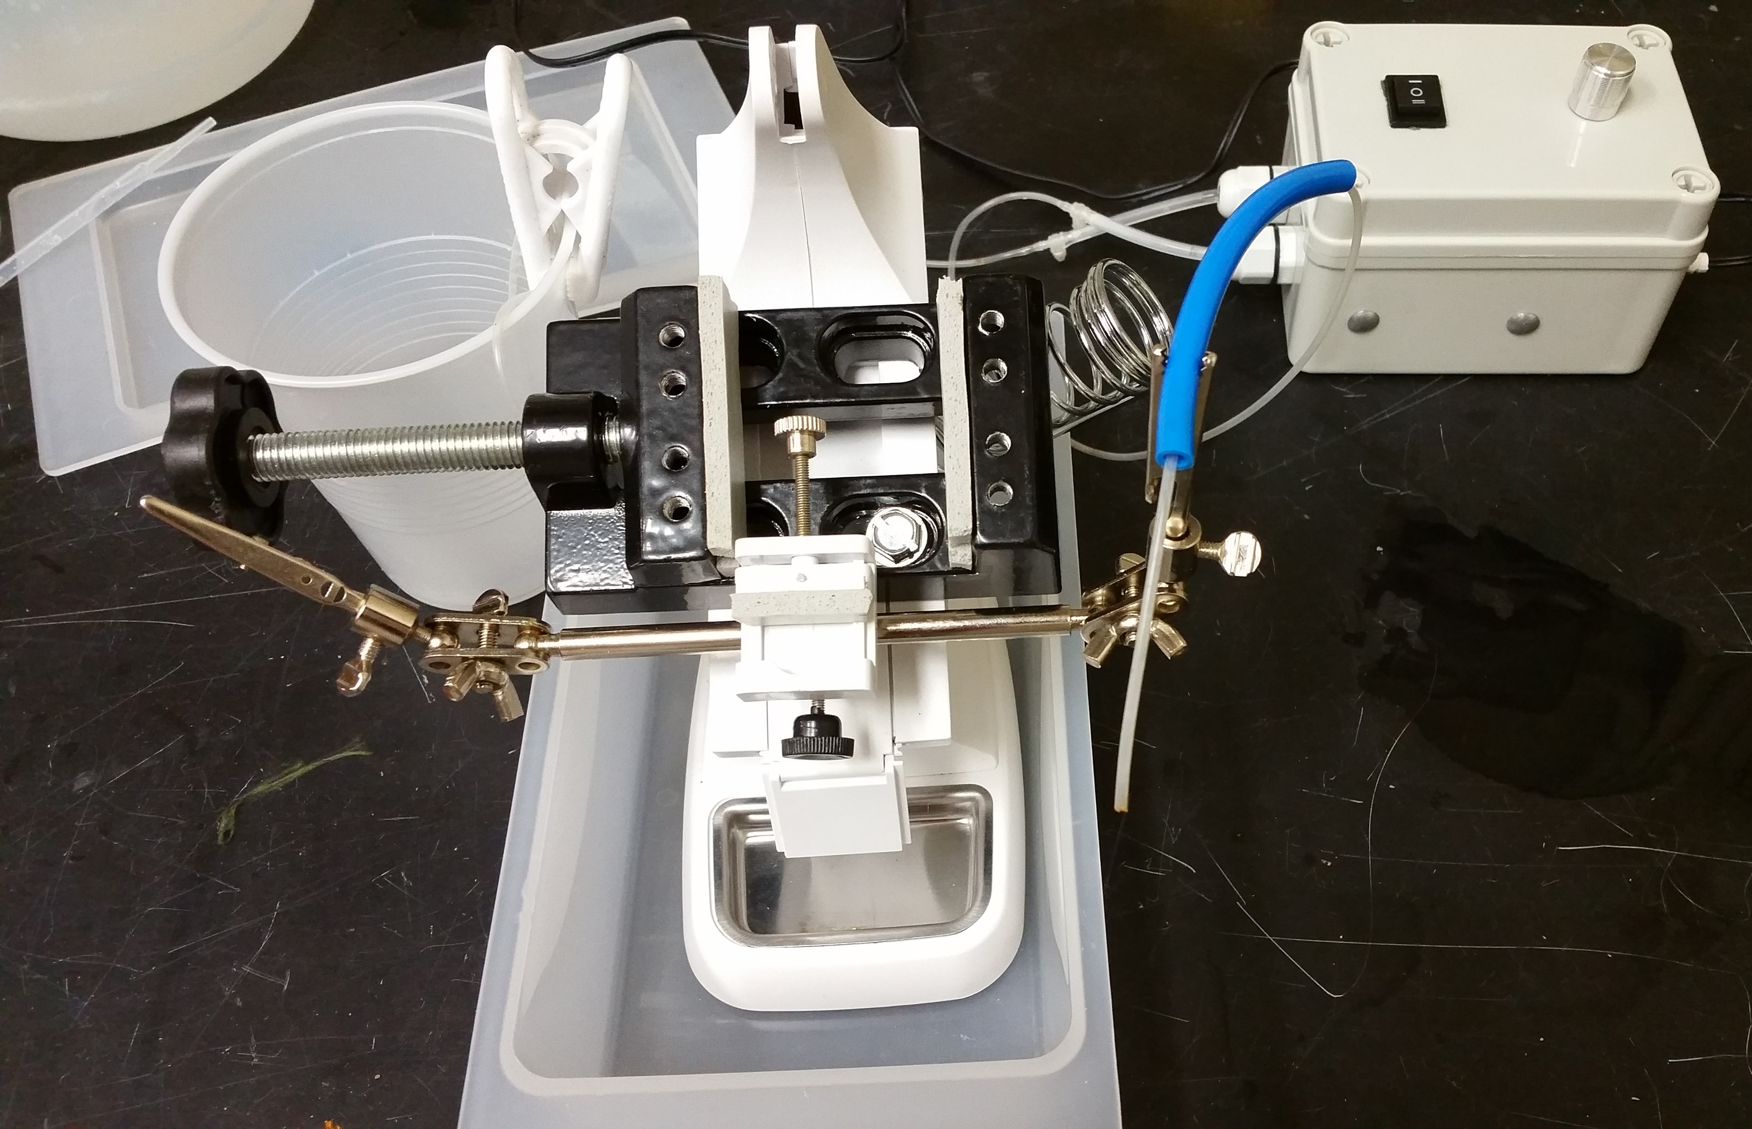
Methods
Promoters Tested:
Time Specific
Short-term (4 – 7 days post injection)
mCMV
Long-term (2 – 5 weeks post injection)
hCMV
Location Specific
Retrograde (labels hard to reach brain areas)
hEF1a
Control:
Saline
Evaluation measures:
Stress measured by breathing rate (opercula beats)
Survival rate
Behavior recovery (nesting for males)
Expression of fluorescent proteins
Notes:
We tested a short-term promotor that altered expression quickly after injection, starting 4 days after injection and lasting for approximately 3 days. We also tried a long-term promotor that caused expression starting 2 weeks after injection and lasting for more than 3 weeks. Finally, we tested a location specific promoter that would label the cell bodies regardless of where in the cell the injection occurred. All 3 were compared against saline injected controls.
We evaluated successful injection by fish recovery as measured by breathing and survival rate, behavioral recovery and altered gene expression, shown by the presence of a fluorescent protein. We found that …

Slide 9
Results
Recovered within 2 hours as measured by breathing rate
High survival rate (80%, n=82)
Behavior recovered after 3 days (nest building)
Fluorescent proteins were expressed for the short- & long-term promotors
Notes:
Fish did recover from these brain injections. Breathing rate returned to normal by 2 hours after injection and we reached an 80% survival rate. Normal nesting and territorial behavior was seen by 3 days after injection for males. Finally, successful manipulation of gene expression was determined by looking for non-natural fluorescence in the brain, that only occurs when the promoter is driving expression. The long term promotor gave the best images and will be our promoter of choice for future experiments. The short term promotor also worked, but the location specific promoter did not. We found that the time specific promoters met our needs because …

Slide 10
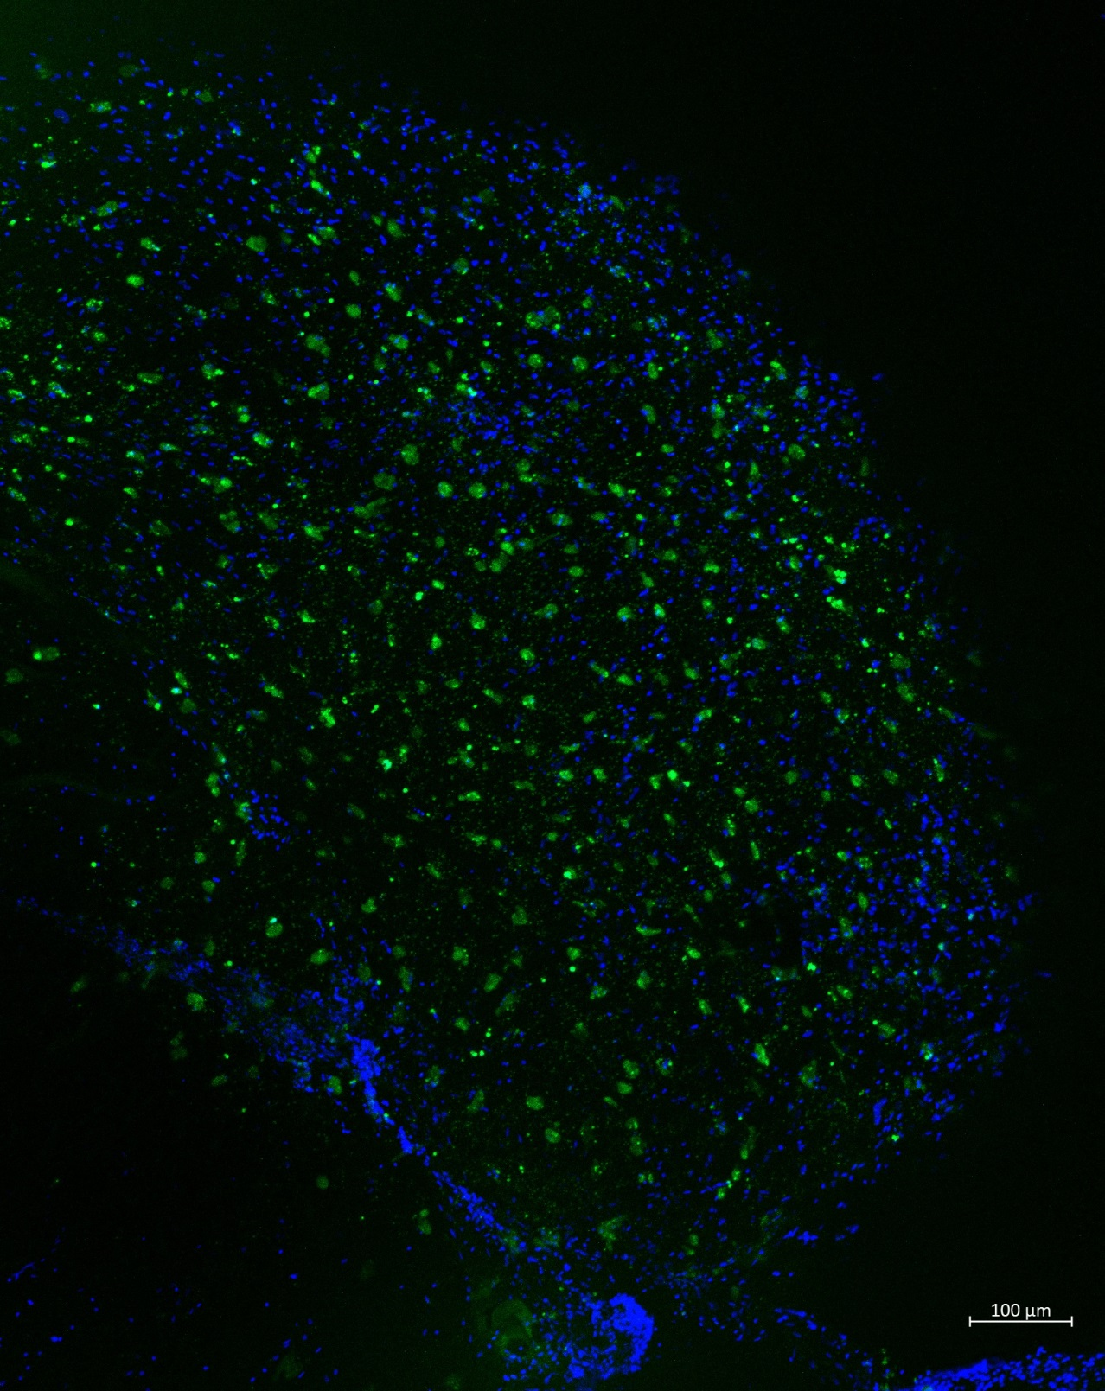
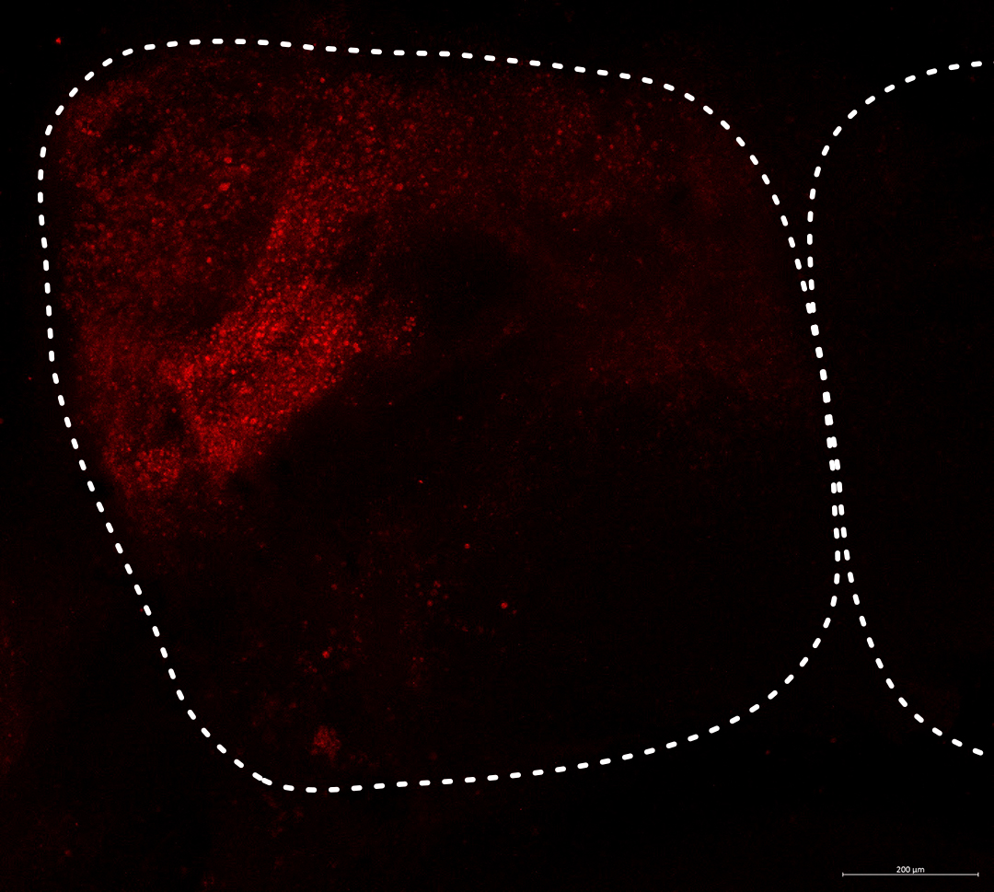
Results: Expression is local
Transfected cell (hCMV-EYFP)
Nuclei (DAPI)
Injection Site
Transfected cell (hCMV-mCherry)
Notes:
There was locally altered gene expression. Here you can see that the expression is limited to the area immediately around the site of injection. This will allow us to determine WHERE behaviorally relevant genes need to be expressed. Even when the injection entered the blood stream, like in this right image, the expression is limited to only one of the brain lobes.
Looking more closely at this brain on the right, we also found that …

Slide 11
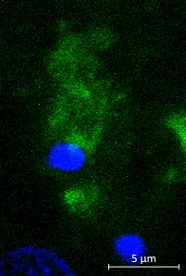
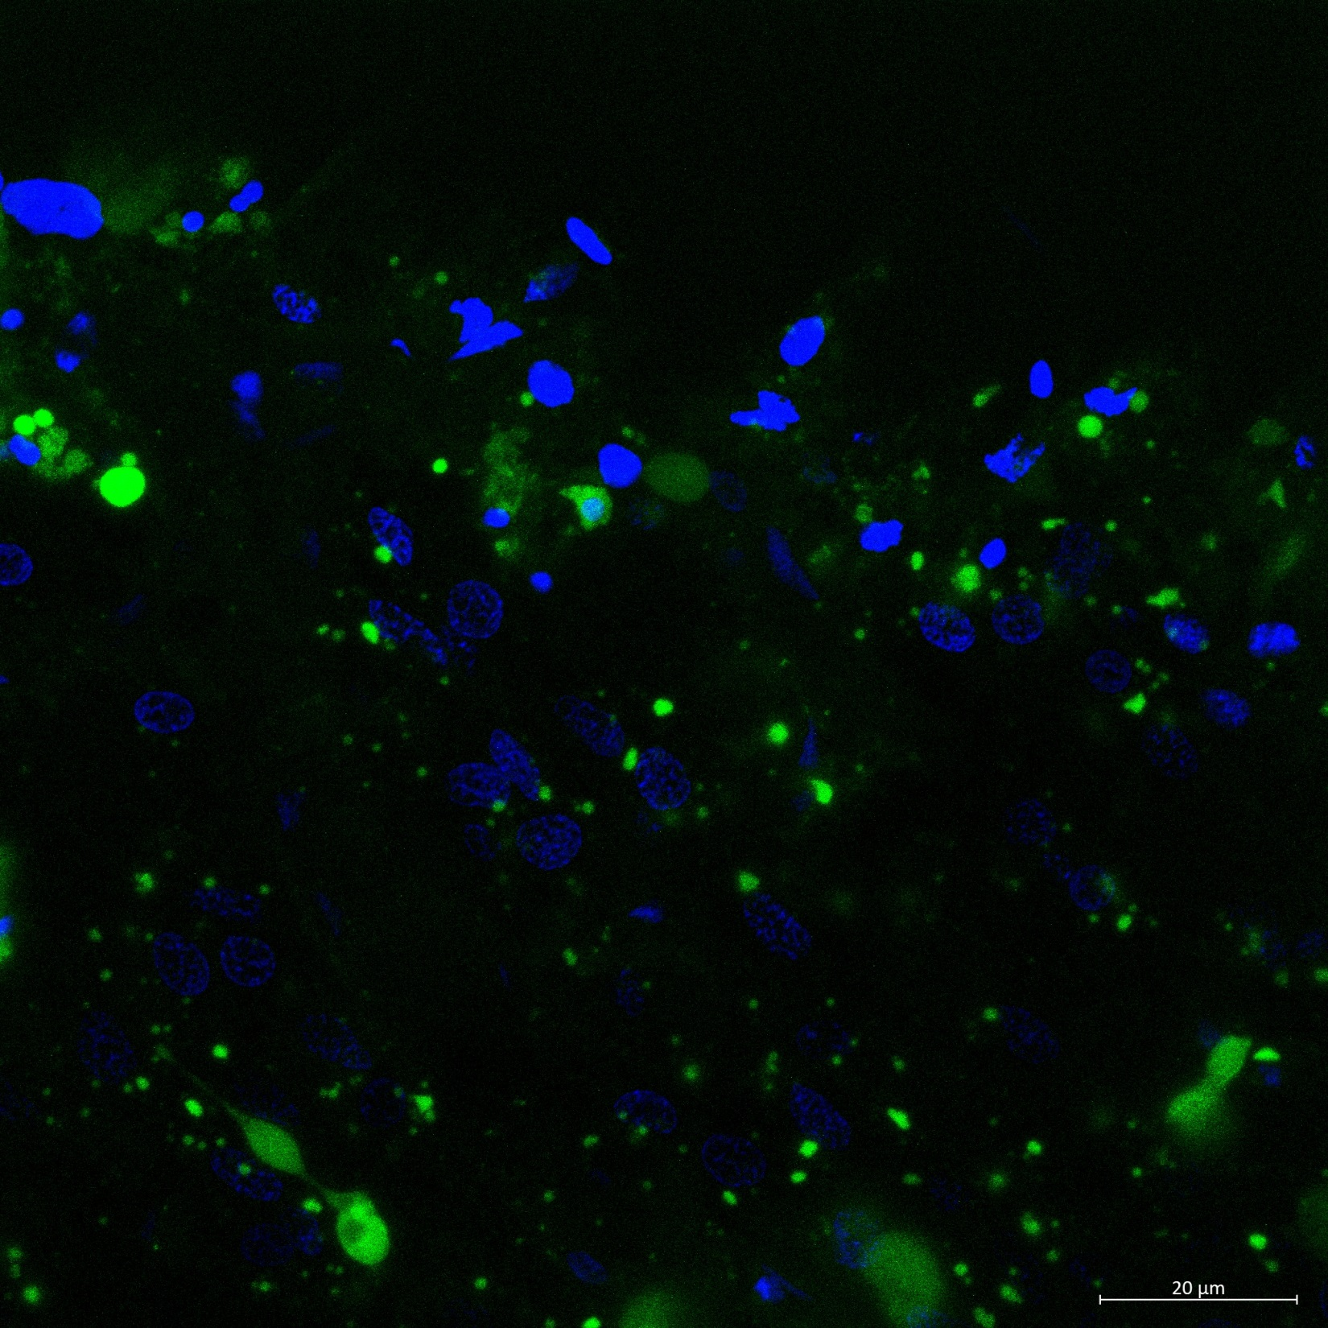
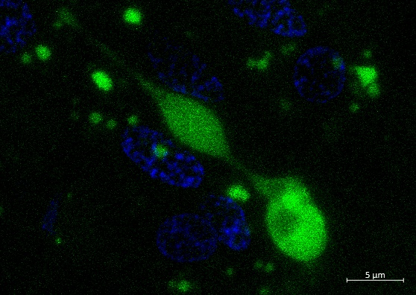
Results: Affects multiple cell types
Astrocyte
Oligodendrocyte
Neuron
Nuclei (DAPI)
Transfected cell (hCMV-EYFP)
Notes:
Multiple brain cell types were affected. Neurons, the classic brain cells expressed the fluorescent protein. I also saw fluorescent structural and supportive cells. PLAY Thus, are now ready to move on to our next stage of experiments – using this method to test several candidate genes for their behavioral relevance.

Slide 12
Future Work
Candidate Genes: prl, ajap1, cacna1g, nsmfb and trpc4
Look for change in behavior
Before injection (no altered expression)
After injection (with altered expression)
Manipulate Gene Expression
Location by fluorescence
qPCR to quantify change
Notes:
To determine where the expression matters, we will look for fluorescence, just as I already showed you. We are also going to measure how much the gene’s expression changed by qPCR. To determine how the gene influences behavior, we will measure behavior for each individual twice both before and after changing the gene’s expression. We expect to have these results by this summer. Thus, …

Slide 13
Big Question
How do genes contribute social behavior?
Which genes?
Where?
When?
Aggression
Parenting
Context switching
Select genes to study
Manipulate gene expression
Look for effects on behavior
Notes:
we can now begin to answer how these genes contribute to the social behavior.
Thank you for listening. Before I take questions, I would like to acknowledge the many people who made this project and my thesis work possible.

Slide 14
Acknowledgements
Bell Lab
Colby Behrens Severin Odland Brianna Bowman
Alison Bell Jennifer Hellmann Jason Keagy Chloé Monestier Abbas Bukhari Miles Bensky Rosie Zhang
Previous Members Rebecca Trapp Molly Kent Laura Stein Emma Murdoch
Undergraduates Joe Dobbins Megan Furukawa Kelly Hynes Sigrid Jin Jennifer Weiss Leslie Pardo Andrew Gensburg Jonathan Sanders Ali Norwood
Construct Source Rachael Neve, Massachusetts General Hospital
Technical Advice & Equipment Roberto Galvez Rhanor Gillette Adam Hamilton & Amy Cash Ahmed of Gene Robinson’s Lab
Graduate Committee Lisa Stubbs Lori Raetzman Justin Rhodes
This work was supported by the National Science Foundation under Grant No. 1645170
Notes:
Specifically, Colby, a graduate student and Severin and Brianna, 2 undergraduates, who helped with the injections. Dr. Roberto Galvez provided invaluable advice and both Drs. Gene Robinson and Rhanor Gillette loaned us equipment. Finally, the NSF who generously funded this method development work with an EDGE grant.
With that, I would like to thank you for your attention and am happy to take any questions you might have.

