Slide 1
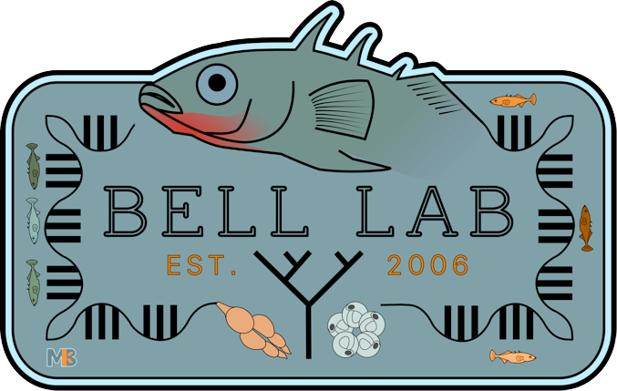
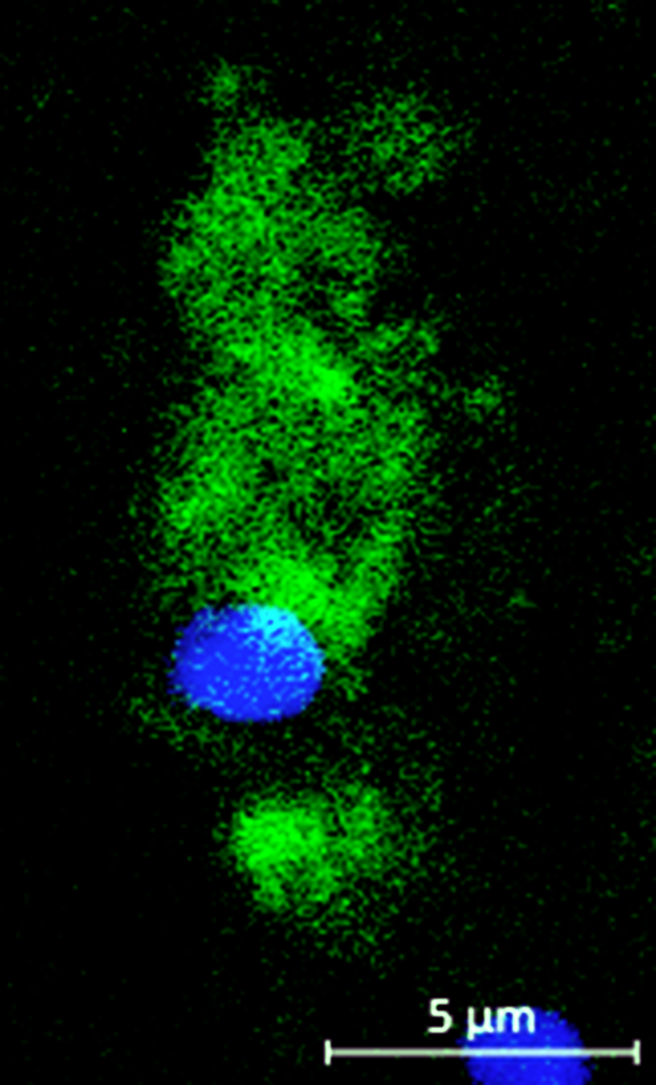
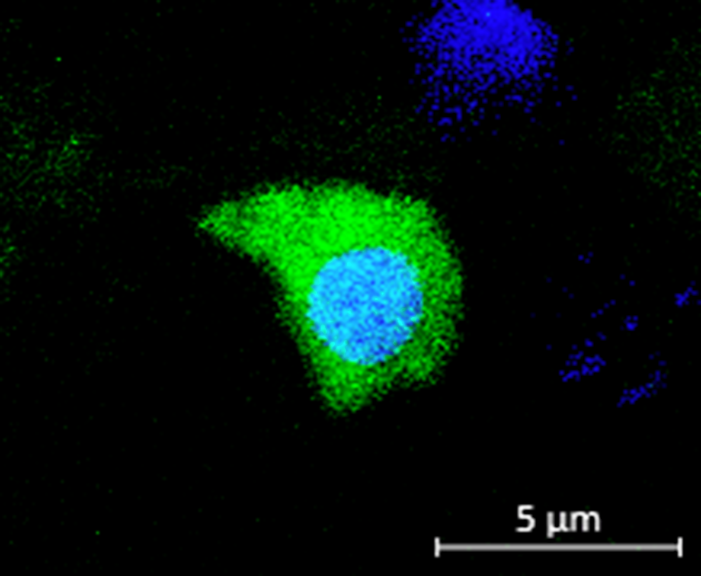
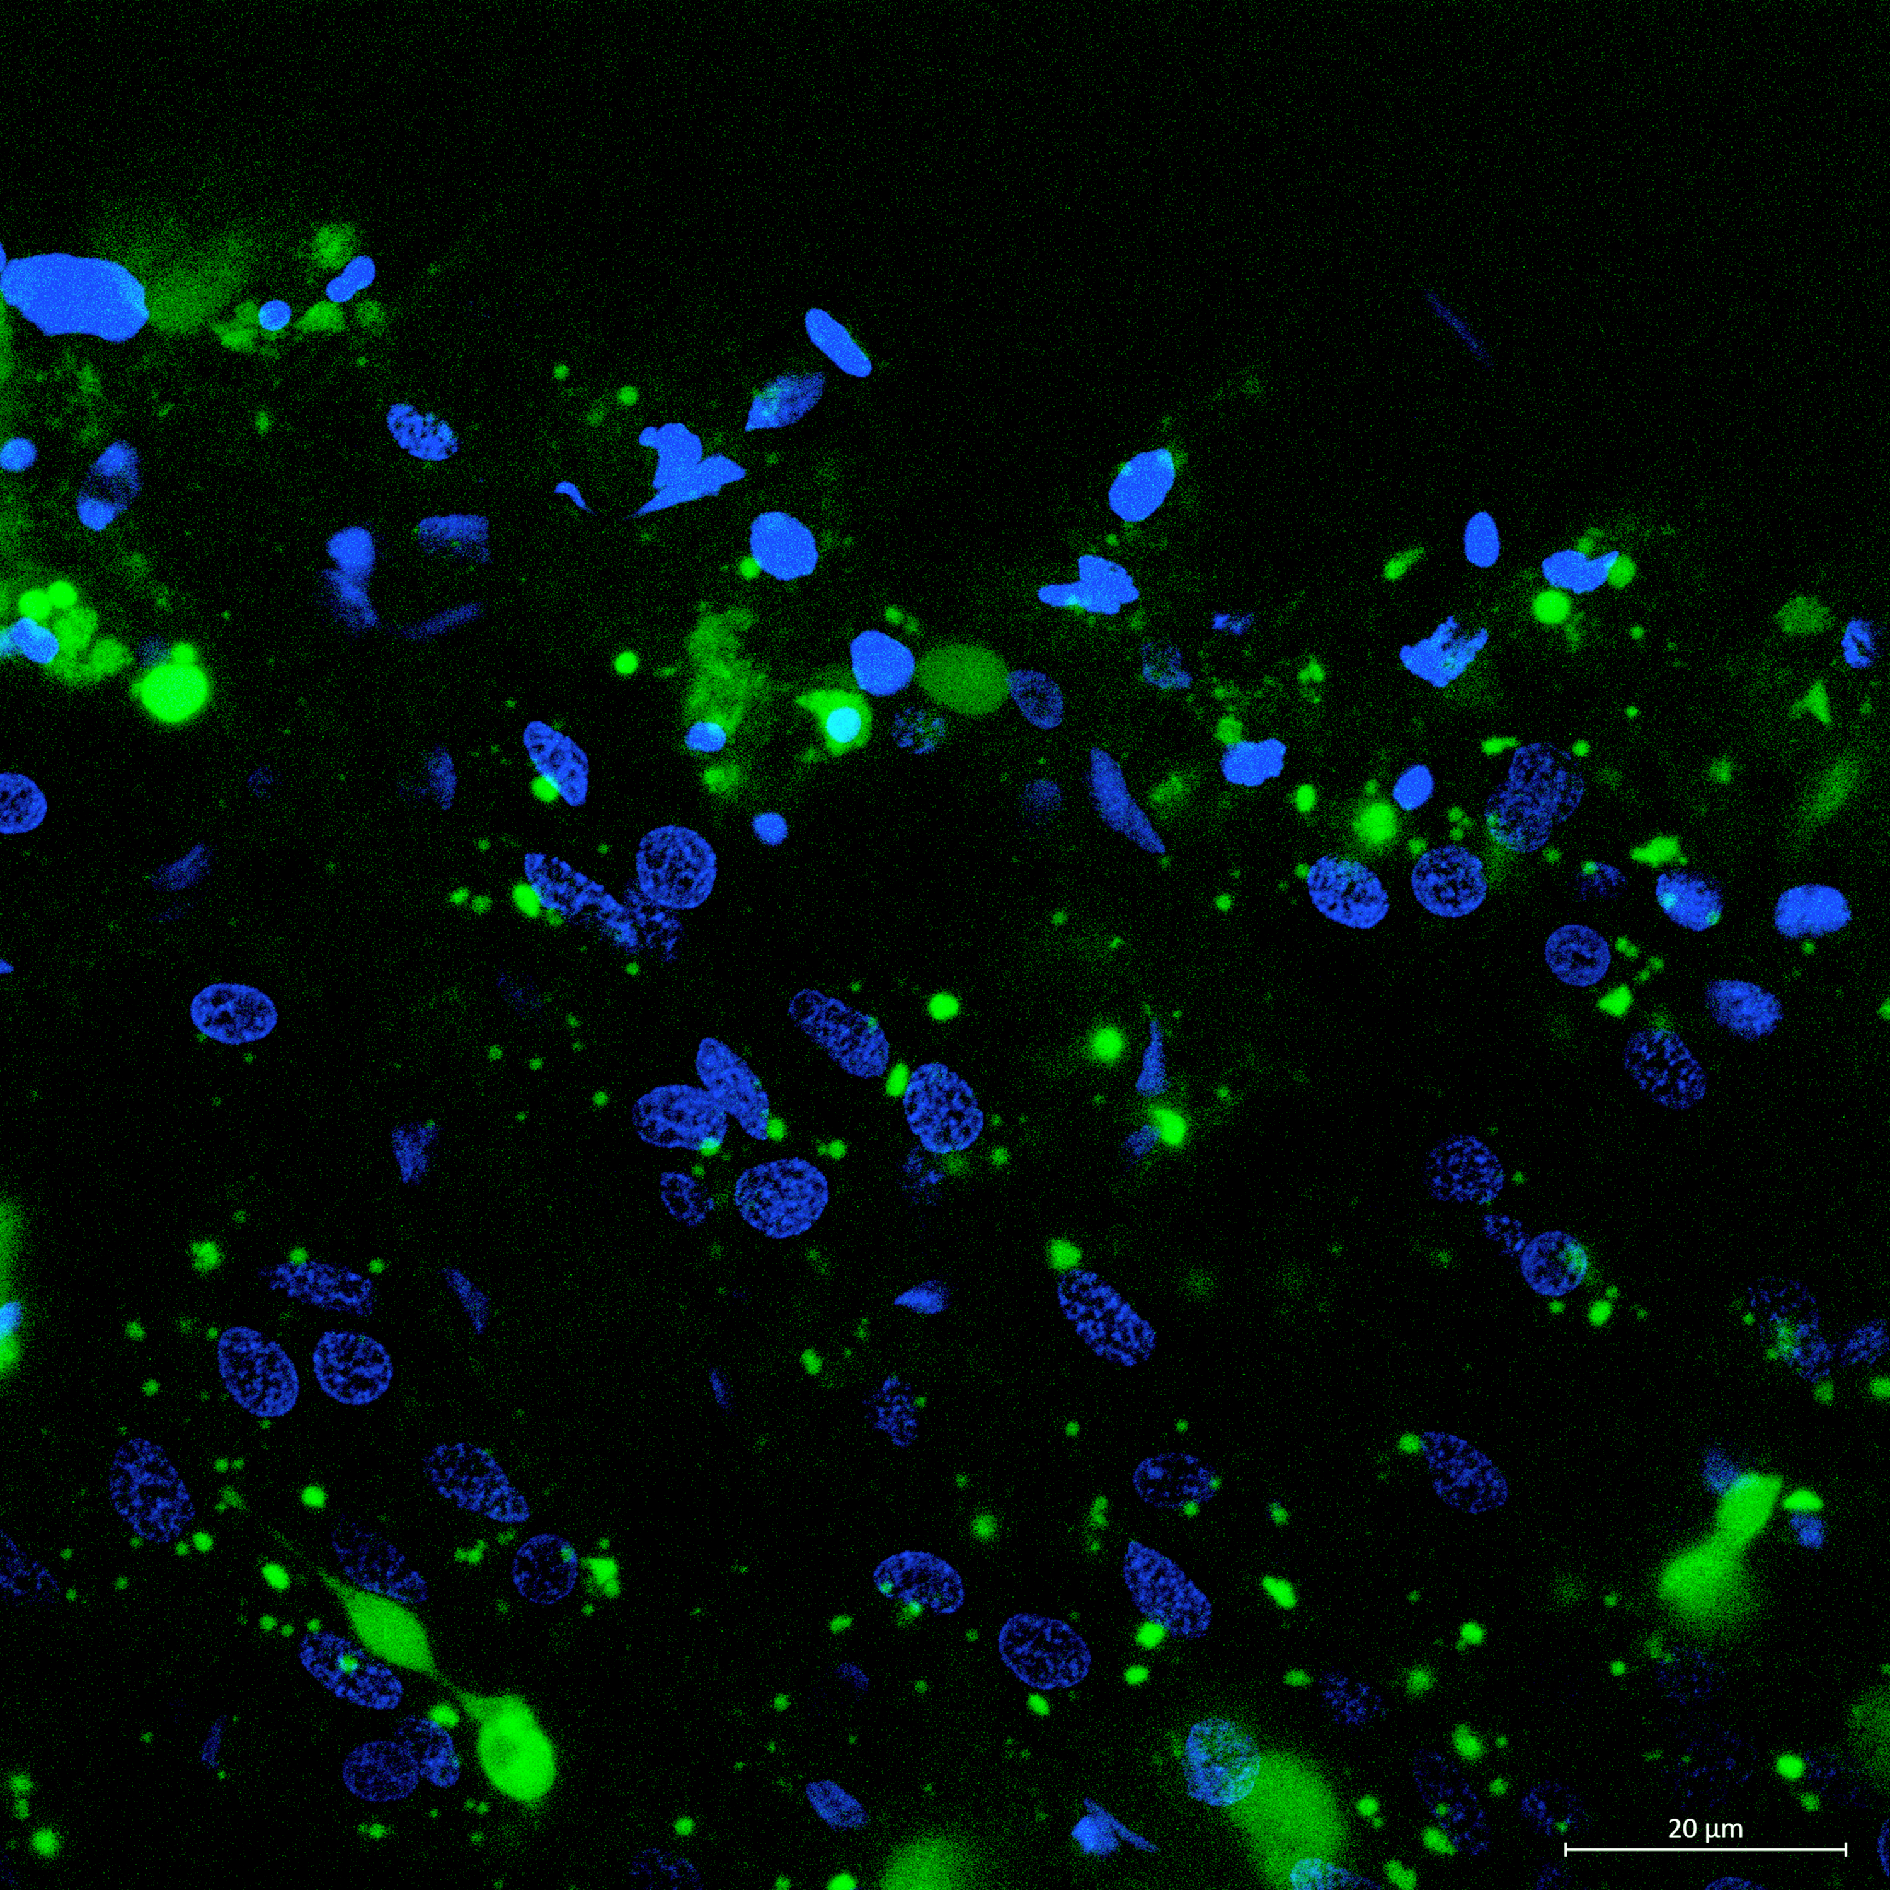
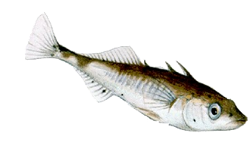
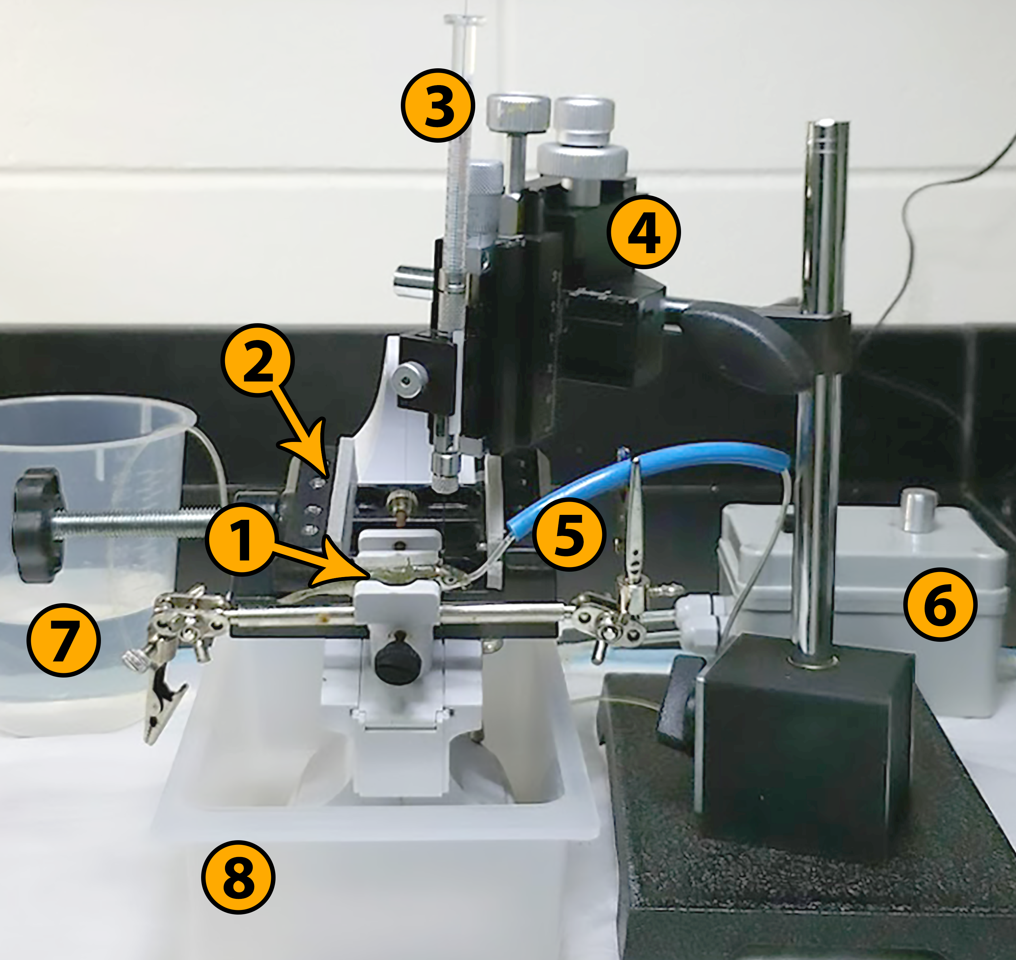
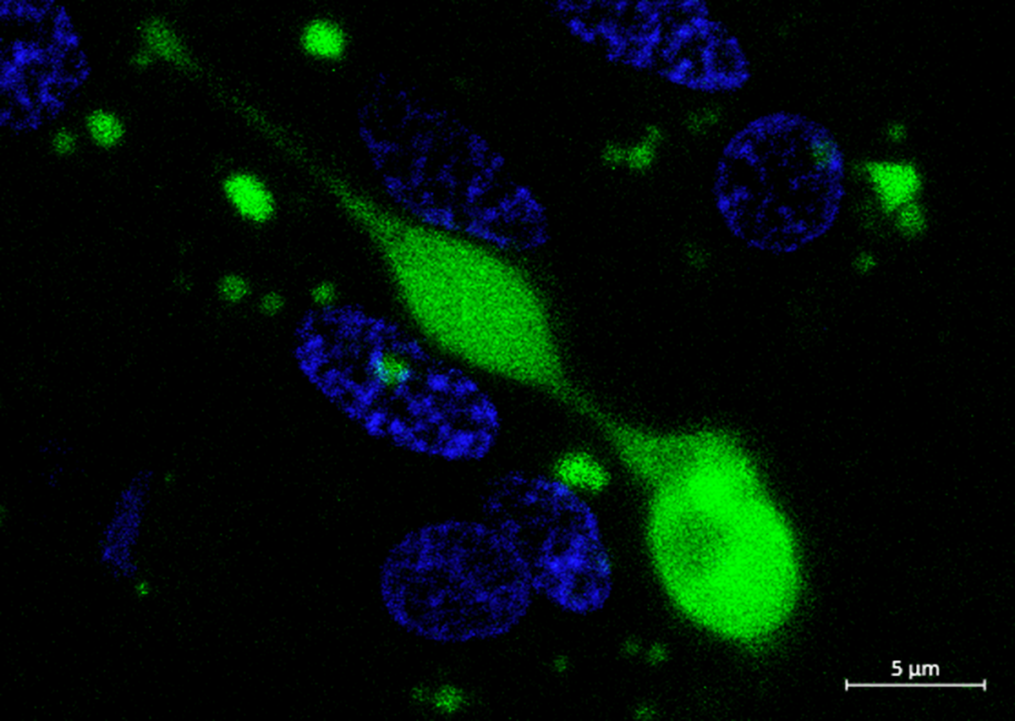
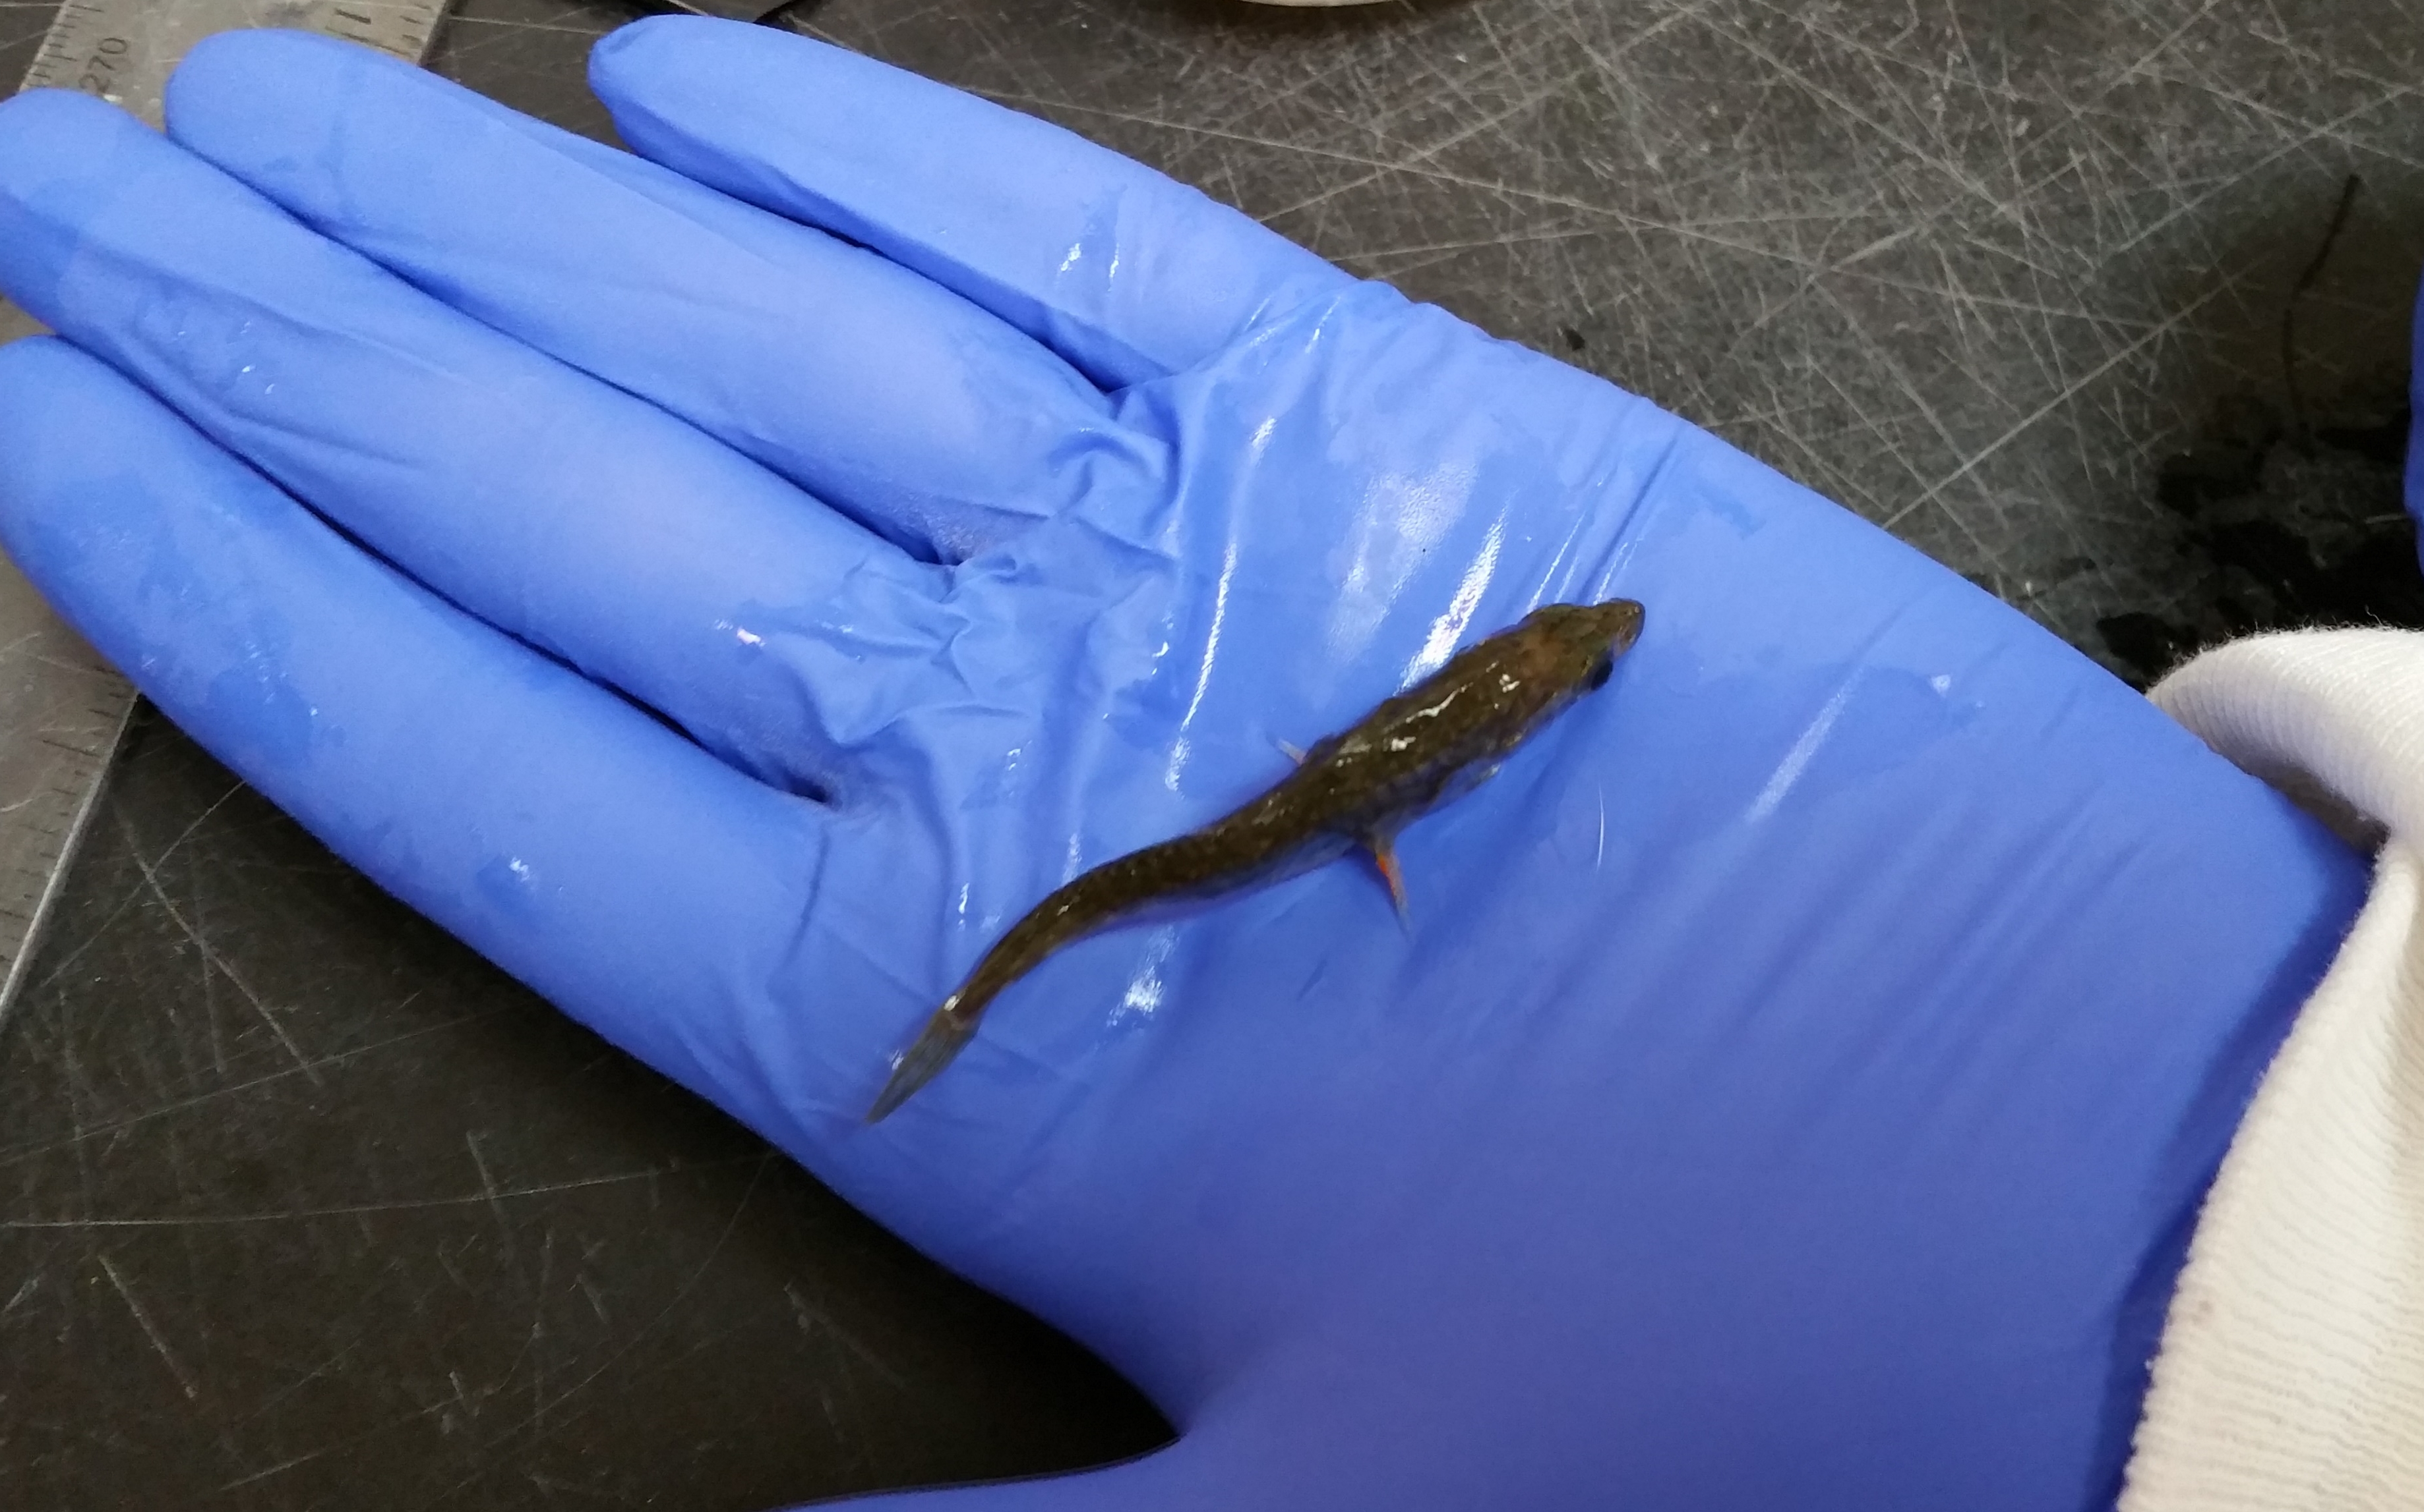
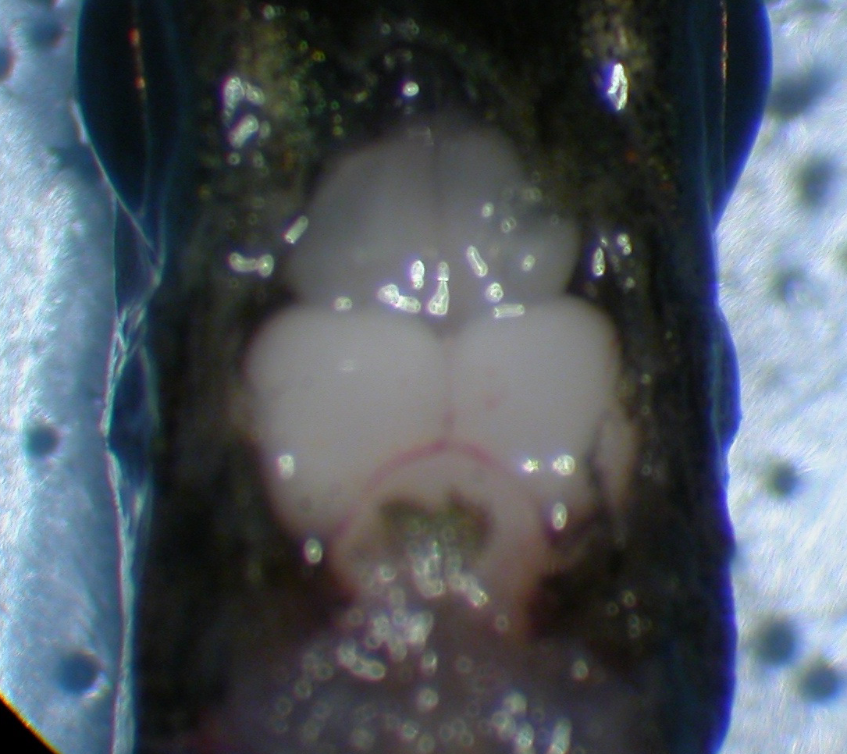
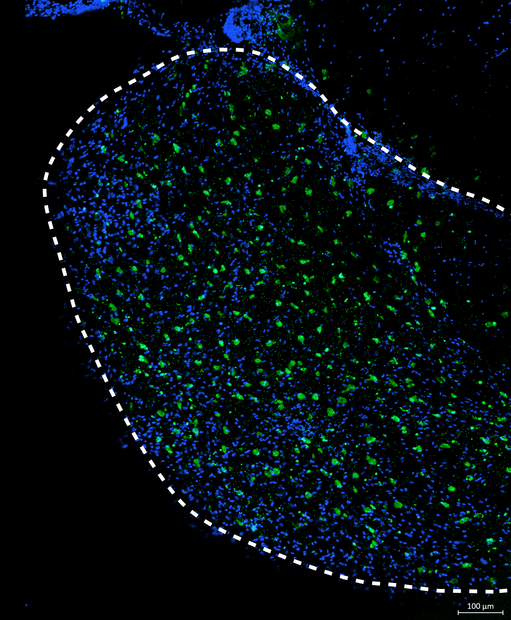
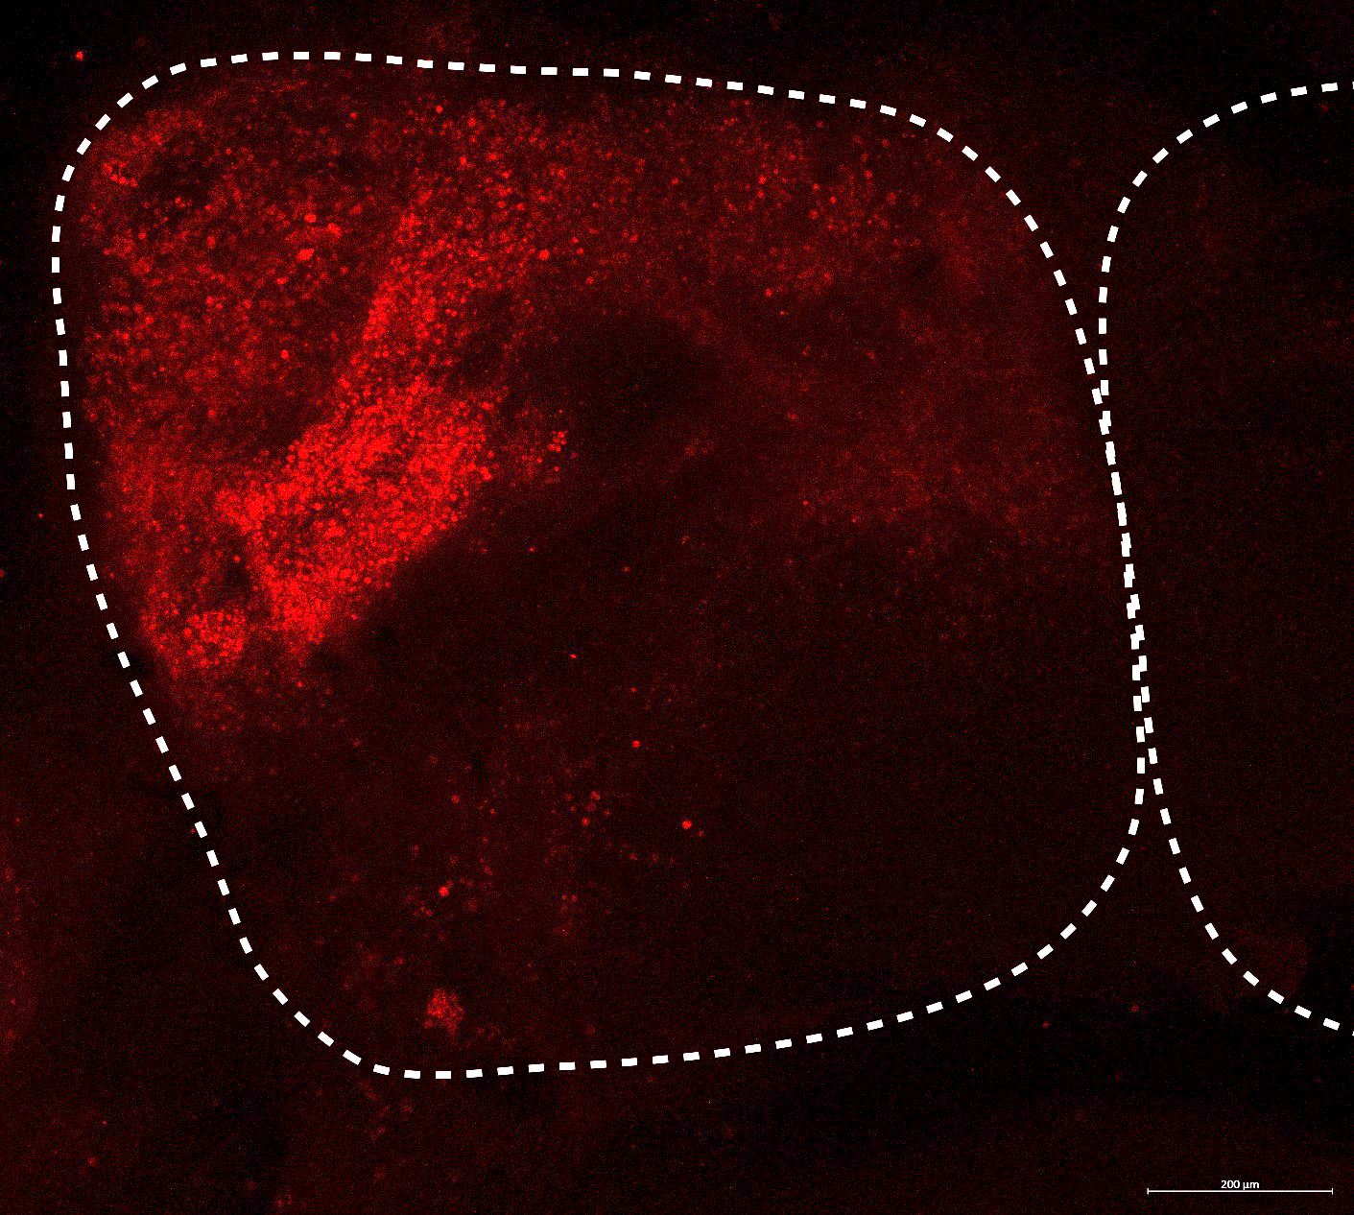
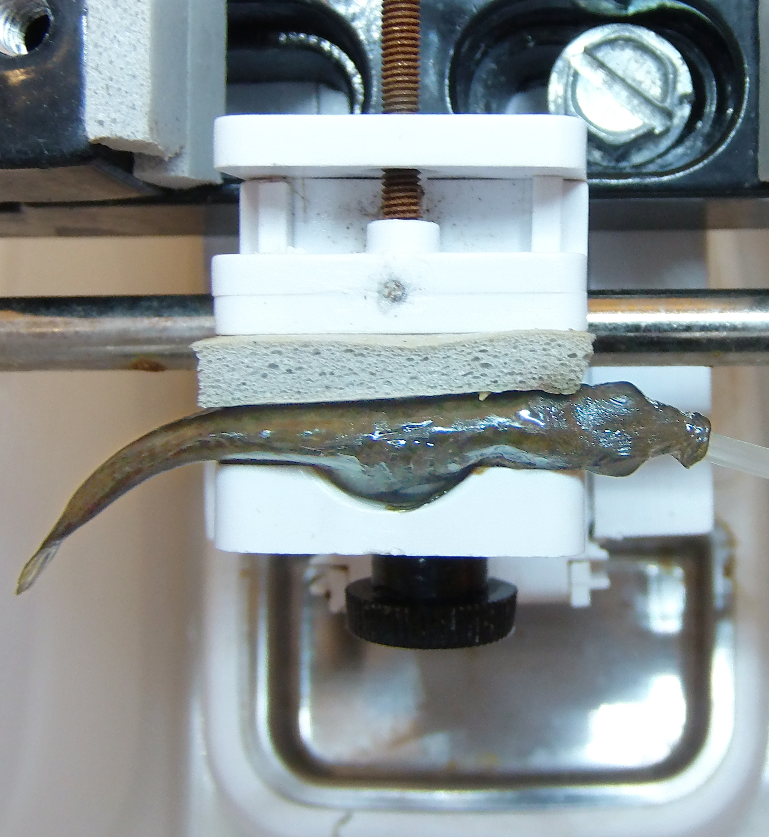
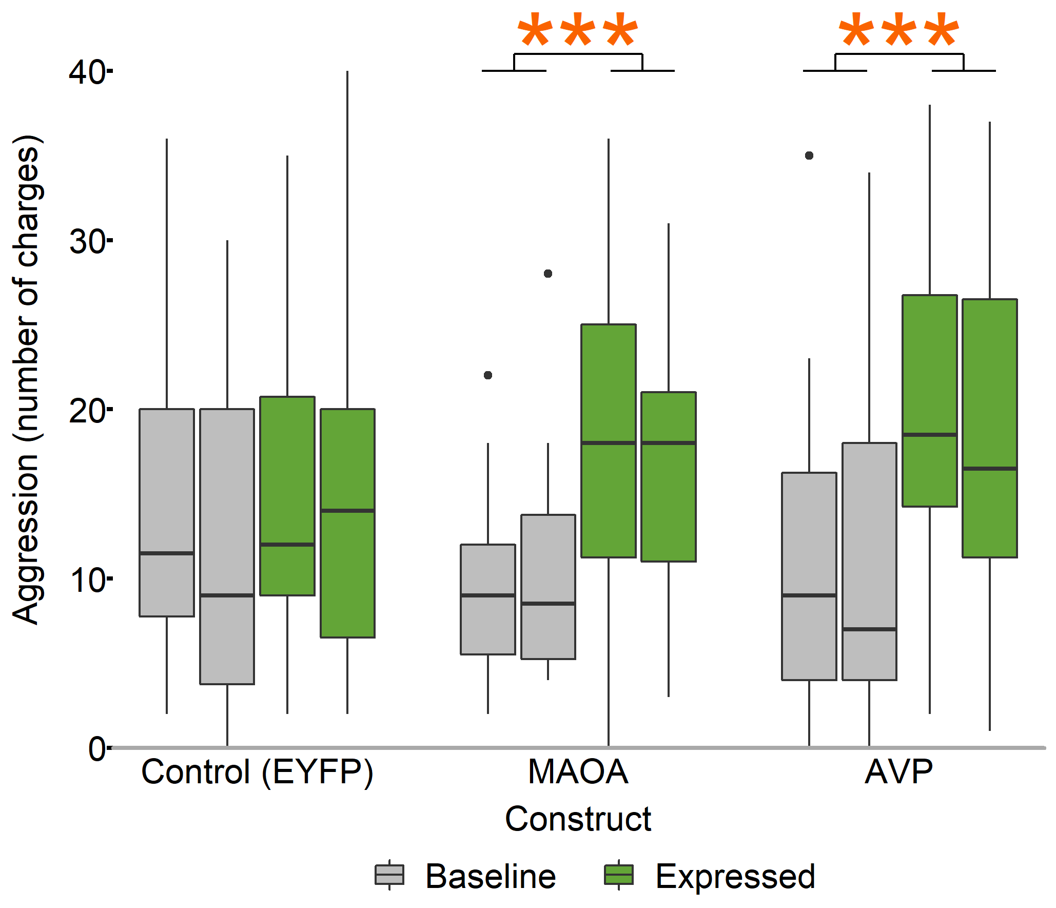
Viral-mediated transgenesis in the brain as a method to determine molecular mechanisms of aggression in stickleback fish
Noelle James¹ and Alison Bell² ¹Neuroscience Program & ²Animal Biology Department at University of Illinois at Urbana-Champaign
How do genes influence behavior?
To study how genes influence social behavior, we need a method to alter gene expression in the brain at a specific time.
Why sticklebacks?
This classic model for studying behavior features:
Numerous independently-derived populations
Sole paternal care
Fully sequenced genome
Established behavioral assays
Several candidate genes for behavior from QTL & RNAseq studies
Why viral-mediated transgenesis?
Flexible: different promoters target different locations or timeframes
Fast: stable transgenic lines aren’t required
Goals of this study:
Develop viral-mediated transgenesis for sticklebacks
Validate technique by fluorescence under microscopy
Demonstrate suitability for behavioral research by altering aggression through manipulation of candidate genes
Neurosurgical Protocol
Direct transcranial injection with an unbeveled ultrafine needle proved simpler and more effective than other piloted techniques, including craniotomy. Use of a 33G needle yielded higher survival rates (88%, n=167) than a larger diameter 30G needle (53%, n=43).
In initial fluorescent testing, a total injection of 300nl (~100nl at 3 different depths) was delivered <2mm below the skull. Two transcranial injections totaling 600nl at <3mm depth were performed during the experimental phase.
Recovery
Post-surgical warning signs:
listing (>45º off central axis)
assuming a nose-up position
loss of positional control (twirling)
The presence of any of these markers for >1 hour suggests a poor prognosis; euthanasia is recommended for these cases.
Fish typically returned to normal swimming and water column use within 15 minutes of surgery. Breathing rate recovery was influenced by number of transcranial injections. Full mating behavior recovery occurred within 3 days.
Transgenic Expression
Successful transfection of multiple cell types
Broad or local expression
Candidate expression
influences behavior
Conclusions
Minimally-invasive neurosurgery
We developed a neurosurgical protocol for stickleback fish.
High (88%) survival rate
Fish survived multiple transcranial injections
Behavior recovery within 3 days
Viral-mediated transgenesis
Transfection using a herpes-derived vector produced expression of gene constructs.
Expression of candidate genes altered behavior
Transfection enables within-individual comparison by producing expression of a selected gene
Construct selection is not limited to native genes: widely available mammalian plasmids successfully altered behavior
Multiple tested promoters successfully drove expression, allowing tailored expression profiles
Astrocyte
Oligodendrocyte
Rapid behavioral recovery makes this a viable approach for direct manipulation of candidate genes.
Neuron
Experimental Overview
Aggression toward a confined intruder was quantitatively assayed in two baseline trials, eight and six days prior to surgery. In a ten minute surgical procedure, a randomly-assigned viral construct was administered to the anterior diencephalon of the brain via transcranial injection. The construct used a broadly-expressed promoter to drive expression of a selected gene. After an incubation period, strong expression of the payload gene occurred in the transfected tissue. Behavior was reassessed in two further trials at 14 and 16 days after surgery.
Candidate genes related to aggression
Arginine vasopressin (AVP), a pituitary hormone important for social behavior, learning, and memory
Monoamine oxidase (MAOA), an enzyme that processes dopamine, norepinephrine & serotonin; associated with depression, antisocial disorders, and Brunner syndrome
Constructs
AVP (human), n=18
MAOA (mouse), n=20
EYFP (fluorescent control), n=16
Mammalian cDNA ORF clones or a fluorescent protein were packaged in replication-deficient herpes virus (HSV-1). Several promoters were piloted; hCMV was the most useful due to its long-term window of effect (2-5 weeks). Mammalian homologs were selected for their wide availability in plasmid form.
Nuclei (DAPI)
Transfected cell (hCMV-EYFP)
Lateral left diencephalon three weeks after injection. Maximum projection of ~2.5 μm whole mount brain.
Hemisphere
boundary
4 mm
Actual size
Actual size
Custom-built surgical apparatus
Left: a stickleback fish in my hand, with brain area highlighted
Right: telencephalon, diencephalon & cerebellum, exposed during dissection
1) Threespine stickleback in padded clamp 2) Alternative padded clamp for larger fish
3) Neuros syringe, 5 μL
4) Three-axis manipulator
5) Oral cannula and guide tube
6) Peristaltic cannula pump, 100 mL/min
7) Pump source reservoir
8) Drip tray
Injection Site
Current Applications
Verification of functional gene alteration is being cross validated with pharmaceutical manipulation, mRNA expression, and circulating hormone levels. Additionally, we are confirming the long-term stability of expression of the hCMV promoter for use in studying parenting.
Previous studies in our lab have provided a large pool of candidate genes for parenting, aggression, and context switching, which can now be evaluated for their direct, organism-level effects. This technique will allow us to isolate the environmental and genetic components of parenting behavior across generations.
Anesthesia & Oxygen
Anesthesia was induced using a 0.02% buffered MS-222 bath for 3-5 minutes. Then, in the surgical apparatus, an oral cannula supplied constant water flow & 0.01% maintenance anesthetic over the gills. This increased the survival rates of longer surgeries.
Hemisphere
boundaries
Nuclei (DAPI)
Transfected cell (hCMV-EYFP)
Transfected cell (hCMV-mCherry)
Broad expression throughout left hemi-sphere of the diencephalon, typical for multiple injections
Single injection resulting in local expression, limited to a portion of one hemisphere of the telencephalon
How do genes influence social behavior?
Aggression increased in transgenic fish that received constructs driving candidate gene expression.
No change in any aggressive behavior occurred in control fish, whose construct drove expression of a novel fluorescent protein.
Which genes?
Where?
When?
Aggression
Parenting
Context switching
Aggression increased in transgenic fish that received constructs driving expression of candidate genes.
No change in any aggressive behavior occurred in control fish, whose construct drove expression of a novel fluorescent protein.
Select genes to study
Manipulate gene expression
Look for effects on behavior
Surgeon’s view, 250% of actual size
Acknowledgements
Thanks to the Bell lab, especially Colby Behrens, Miles Bensky, Severin Odland, Christian Zielinski, and Rachael Kirchschlager, for their assistance on these experiments. Dr. Rachael Neve of the Massachusetts General Hospital’s Gene Delivery Technology Core helped with construct design and viral packaging. Dr. Rhanor Gillette and Dr. Gene Robinson provided equipment. Brian James assisted with surgical apparatus design and construction. Additional experimental design advice was provided by my thesis committee of Dr. Lori Raetzman, Dr. Justin Rhodes, and Dr. Lisa Stubbs. Imaging was performed on a Zeiss LSM 710 at the Core Facilities at the Carl R. Woese Institute for Genomic Biology.
All animal work was done in accordance with IACUC protocol 18080. Neurosurgery consultations provided by Dr. Helen Valentine, DVM, MS, DACLAM & Dr. Jennifer Criley, DVM, DACLAM.
This work was supported by the NSF through EDGE Grant #1645170. Travel support provided by a SFN Professional Development Award through the Neuroscience Scholars Program.
References
Bukhari, S. A., Saul, M. C., Seward, C. H., Zhang, H., Bensky, M., James, N., … Bell, A. M. (2017). Temporal dynamics of neurogenomic plasticity in response to social interactions in male threespined sticklebacks. PLOS Genetics, 13(7), e1006840.
Neiffer, D. L., & Stamper, M. A. (2009). Fish sedation, anesthesia, analgesia, and euthanasia: Considerations, methods, and types of drugs. ILAR Journal, 50(4), 343–360.
Sladky, K. K., & Clarke, E. O. (2016). Fish Surgery: Presurgical Preparation and Common Surgical Procedures. Veterinary Clinics of North America - Exotic Animal Practice, 19(1), 55–76.
Zou, M., De Koninck, P., Neve, R. L., & Friedrich, R. W. (2014). Fast gene transfer into the adult zebrafish brain by herpes simplex virus 1 (HSV-1) and electroporation: methods and optogenetic applications. Frontiers in Neural Circuits, 8(May), 41.
Contact Me
nholmes3@Illinois.edu
Notes:
Modified stickleback artistic rendering provided by Alison Bell. Brain dissection modified from image provided by Molly Kent.

